Slide 1
Introduction to Machine Learning with Python
By Viktor Reichert
viktor.reichert@conteco.gmbh

Slide 2
Greetings!
Who am I?
What are my tasks?
My experiences with Python…
My experiences with data science…
Do I have a kaggle account?
My favorite outdoor activity is…

Slide 3
What is Machine Learning
Definition: Machine learning is a branch of AI that enables computers to learn and make predictions without explicit programming.
Learning process: It involves training algorithms with data to recognize patterns and make accurate predictions.
Types: Supervised, unsupervised, semi-supervised, reinforcement, and deep learning.
Applications: Healthcare, finance, marketing, autonomous vehicles, image recognition, natural language processing, recommendation systems, and fraud detection.
Challenges: data quality, bias, interpretability, ethics, and privacy.

Slide 4
What is Machine Learning
Data analytics: Analyzing and interpreting data to uncover patterns, trends, and insights.
Data mining: Discovering patterns and relationships in large datasets using statistical analysis and machine learning. (Subset of data analytics)
Data science: Multidisciplinary field combining data analytics, data mining, programming, and statistics to extract insights and solve complex problems.

Slide 5


Python 3
Python is a programming language developed since 1991 (created from Guido van Rossum)
Some of python‘s key attribute are:
Simplicity (clean and readable syntax)
Versitile (general-perpose: web development, scientific computing, machine learning,…)
Strong Community (many libraries)
Cross-plattform compatibility
We will use Jupyther Notebook to work with Python 3.
Link to Notebook: https://www.kaggle.com/code/viktorreichert/introduction-to-python

Slide 6

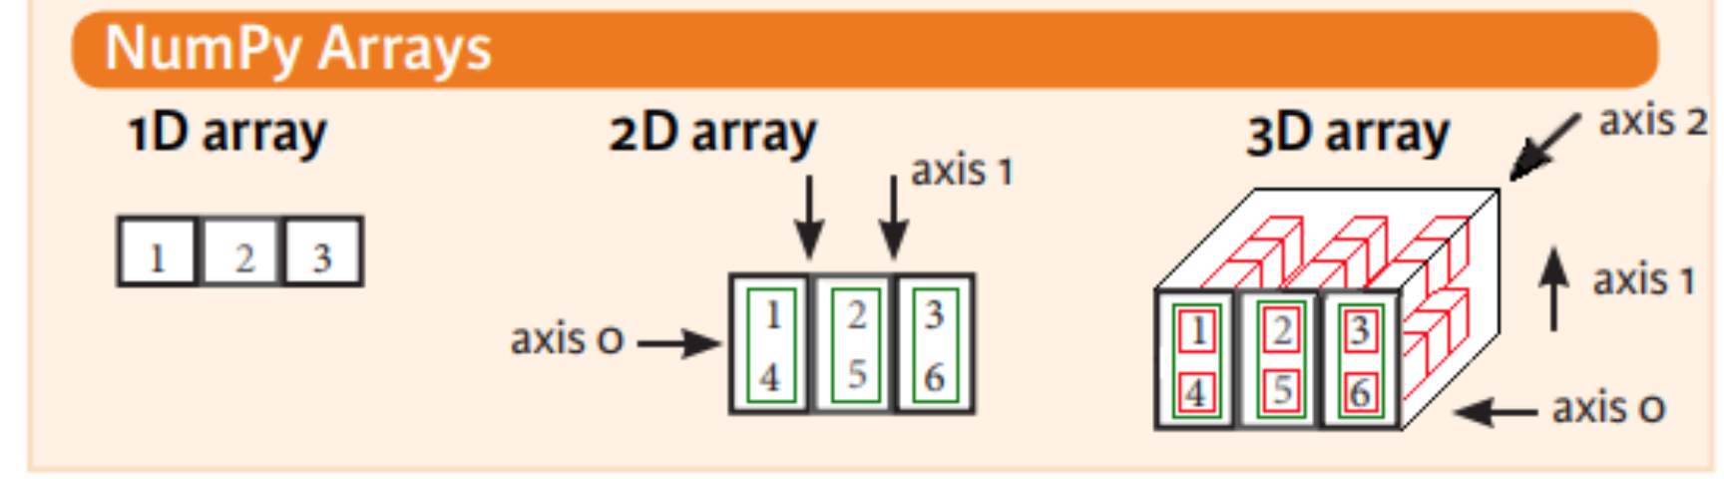
Working with matricies
The most used framework for working with matricies is numpy.
Matricies of any shape are implemented as ndarrays (n-dimensional arrays).
Numpy is extremly fast.
Other frameworks (like pandas) use numpy under the hood.
Open Source.
Is always imported as np.

Slide 7

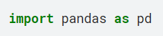
Working with tabular data
pandas ist the most used Framework for using tabular data.
Open Source.
Is always imported as pd.

Slide 8

scikit-learn
scikit-learn is an open source library for python. Many different machine learning algorithms are implemented here.
One of it‘s key features is the easy usage.

Slide 9
Pandas
pandas ist the most used Framework for using tabular data.
Open Source.
Is always imported as pd.

Slide 10


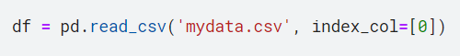
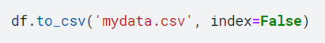
CSV einlesen und speichern
CSV
The read_csv method can be used to load CSV files as DataFrames. With this, the column types usually have to be adjusted.
When reading in files, the index column(s) can be specified with the "index_col" parameter.
With the to_csv method, a DataFrame can be transferred as a CSV.
The "index" parameter can be used to indicate whether this should be saved.

Slide 11
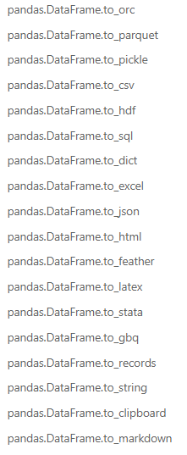
Other formats
Pandas supports many other storage and export formats.

Slide 12
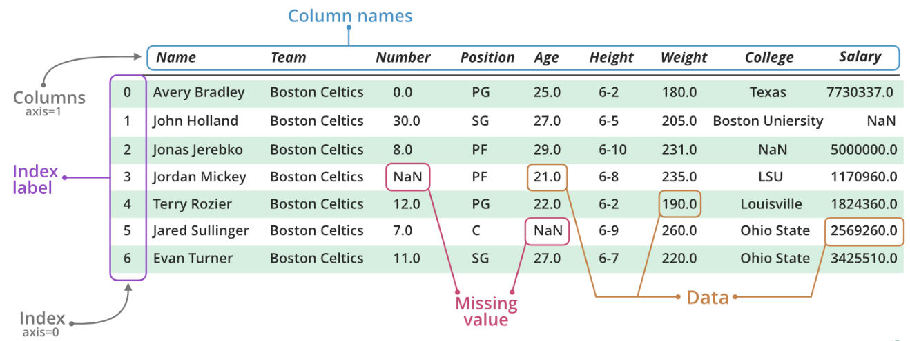
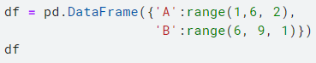
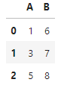
DataFrame
A DataFrame represents a table in pandas.
Each column has a name, each row an index.
Index and columns can consist of several levels and do not have to be unique.
Notes:
Bild: https://www.geeksforgeeks.org/creating-a-pandas-dataframe/

Slide 13
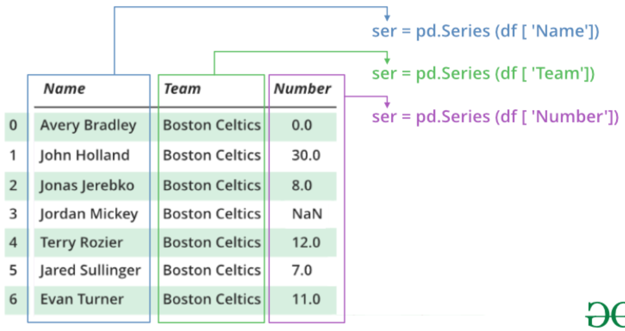
Series
The columns of a DataFram are of type Series.
Notes:
https://www.geeksforgeeks.org/python-pandas-series/?ref=lbp

Slide 14
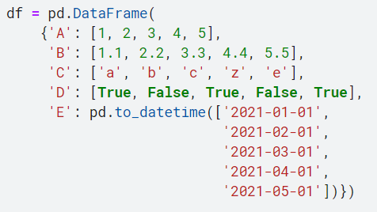
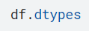
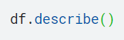
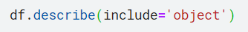
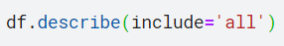
First step of EDA
The methods describe and info help to get a fast overview about the metrics.
You can use dtypes to get the dtypes of the columns.
Notes:
import pandas as pd
df = pd.DataFrame(
{'A': [1, 2, 3, 4, 5],
'B': [1.1, 2.2, 3.3, 4.4, 5.5],
'C': ['a', 'b', 'c', 'z', 'e'],
'D': [True, False, True, False, True],
'E': pd.to_datetime(['2021-01-01',
'2021-02-01',
'2021-03-01',
'2021-04-01',
'2021-05-01'])})

Slide 15
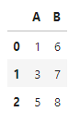
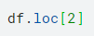
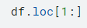
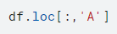
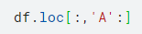
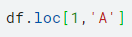
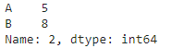
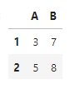
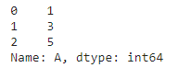
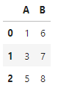
Access
With iloc, loc you can access single cells, columns or rows.
The syntax is the same as slicing.
iloc expects integers as parameters(1. row, 5. column)
loc expects colomn and index names (Index: 5, column: ‚name‘)
loc → Location, iloc → Integer Location.

Slide 16
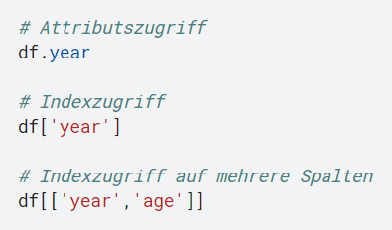
Accessing columns
Columns can be accessed using attribute or index notation. You then get back the series of the column.
A list of column names can also be passed as an attribute. You then get back a DF with these columns.
The return references the same elements in memory! (It’s a view, not a copy)
In order to always allow attribute access to a column, it should not have spaces in its name.

Slide 17
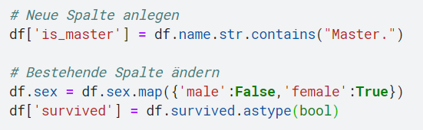
Adding/Changing Columns
A new column can be created in a DataFrame via an index assignment.
Existing columns can also be changed in this way.
Existing columns can also be changed via attribute access, but new ones cannot be created!

Slide 18
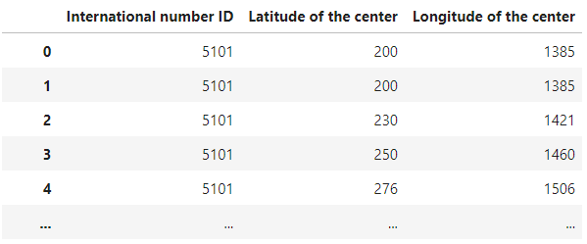
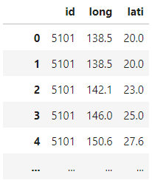
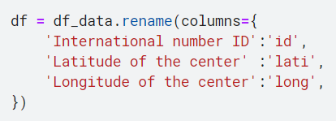
Renaming columns and index
Use rename to change the names of columns and index.
Best practice is to define a dictionary that contains the old names as keys and the new names as values.
Alternative: rename_axis

Slide 19
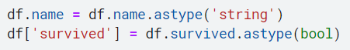
Changing datatypes
The method astype can be used to change the type of a column.
There are also other methods available for special types:
to_numeric (good for turning strings into numbers or using the "downcast" parameter to reduce disk space)
to_datetime
to_timedelta

Slide 20
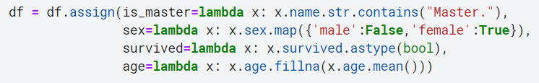
Add/change columns functionally
In functional notation, assign can be used to add new columns and change existing columns.
The parameter passed in the lambda always represents the entire DataFrame.
name | sex | survived | age
Braund, Mr. Owen | male | 0 | 22
Behr, Master. Karl | male | 1 | 24
Futrelle, Mrs. Heath | female | 0 | nan
name | sex | survived | age | is_master
Braund, Mr. Owen | False | False | 22 | False
Behr, Master. Karl | False | True | 24 | True
Futrelle, Mrs. Heath | True | False | 23 | False

Slide 21
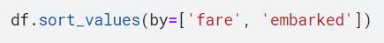
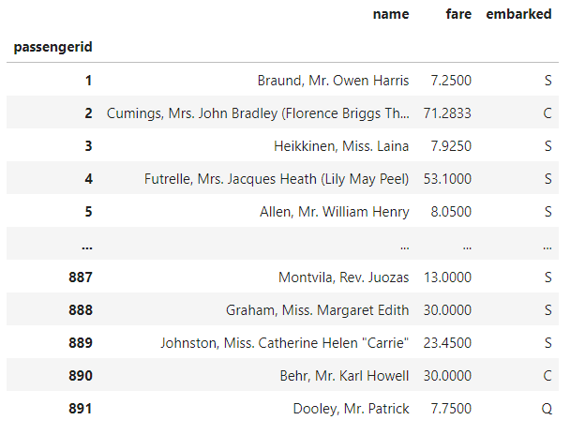
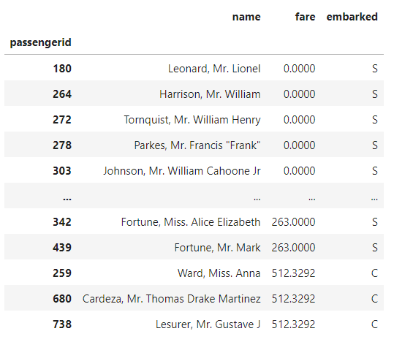
sorting
Use sort_values to sort based on one or more columns.
The "by" parameter must always be specified for DataFrames. This is not necessary for a series.

Slide 22
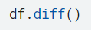
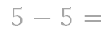
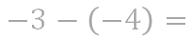
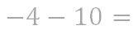
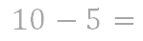
Differences of consecutive values
diff can be used to calculate the differences between two consecutive lines. The first index is filled with NaN or NaT.
It is very well suited for determining time differences.
Data types of the result are float64 or timediff!
A | B
5 | 2021-01-01
5 | 2021-02-01
10 | 2021-03-01
-4 | 2021-04-01
3 | 2021-05-01
A | B
NaN | NaT
0.0 | 31 days
5.0 | 28 days
-14.0 | 31 days
7.0 | 30 days
$$5−5=$$
$$10−5=$$
$$−4−10=$$
$$−3−\left(−4\right)=$$

Slide 23
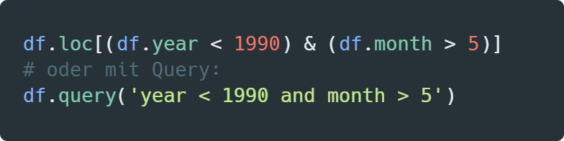
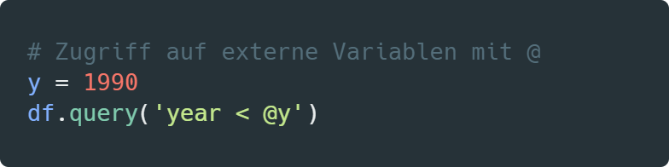
Filtering Data with Queries
Pandas.DataFrame.query

Slide 24
function wrapper
Methode on DF | Parameter of Callback Funktion | Explanation
apply | Applies function to entire column/row. | Applies function to entire column/row.
applymap | Cell | Applies function on each cell.
aggregate agg | Column (default, axis=0), Row (axis=1) | Applies aggregation function to entire column/row.
transform | Column (default, axis=0), Row (axis=1) | Applies function to column/row. The result must be exactly the same size as the input.
assign | DataFrame (A **Dictionary with column name and function is transferred) | Invert methods to get new database columns.
pipe | DataFrame | Applies aggregation function to entire DataFrame.
Method on Series | Parameter of Callback Funktion | Explanation
map | Cell | Applies dictionary or function to values.

Slide 25
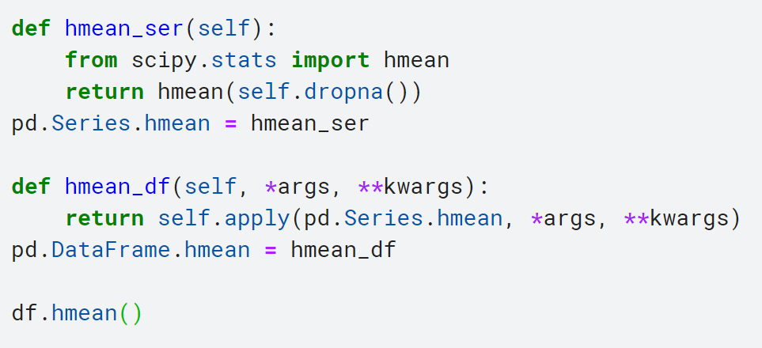
Adding more class methods
To more easily use self-defined methods via DataFrames and Series, these can be added as class methods.

Slide 26
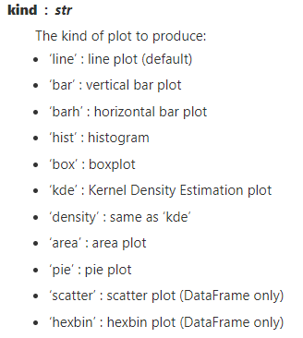
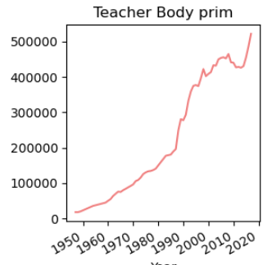
Plotting a DataFrame
DataFrames can be easily transformed and displayed using the plot method in Matplotlib-Axis.
There are a number of possible diagrams:

Slide 27
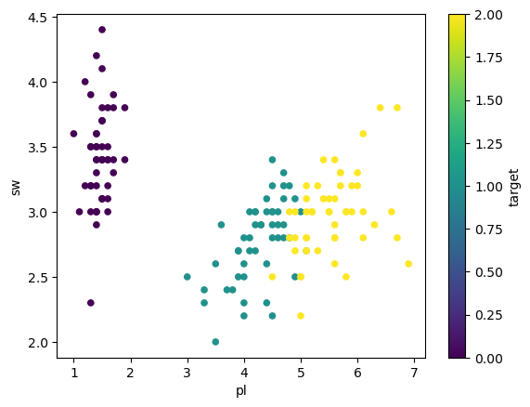
Scatter Plot

Slide 28
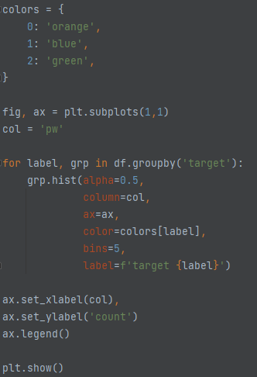
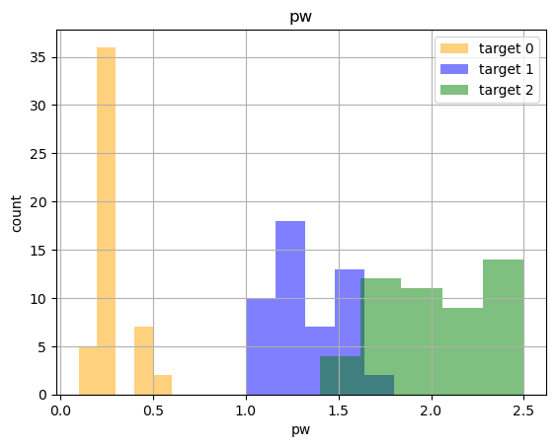
Histogramme

Slide 29
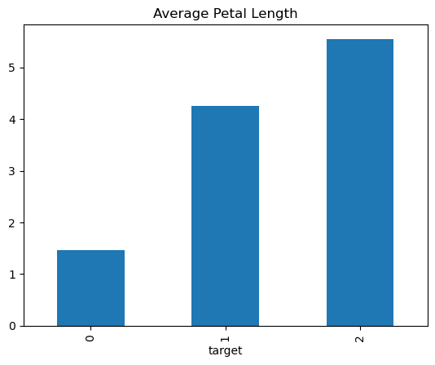
Bar Plot

Slide 30
Connection to Numpy
Since all DataFrames/Series are also numpy arrays, all numpy functions can be applied to them.
This can even lead to very good running times.

Slide 31
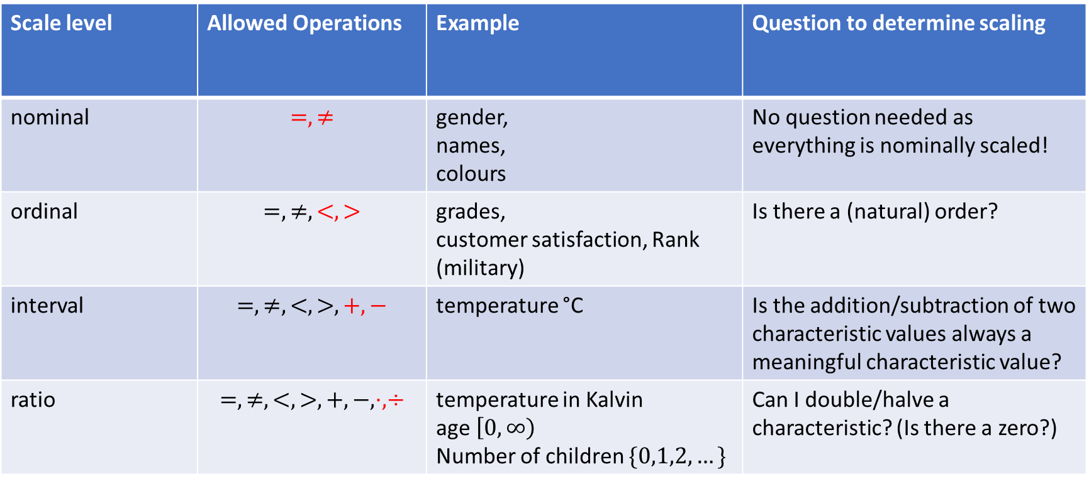
Scale level of variables
Scales build on each other!
E.g.: everything that is scaled ordinal is also scaled nominal.
Scale level | Allowed Operations | Example | Question to determine scaling
nominal | $$=,≠$$ | gender, names, colours | No question needed as everything is nominally scaled!
ordinal | $$=,≠,<,>$$ | grades, customer satisfaction, Rank (military) | Is there a (natural) order?
interval | $$=,≠,<,>,+,−$$ | temperature °C | Is the addition/subtraction of two characteristic values always a meaningful characteristic value?
ratio | $$=,≠,<,>,+,−,⋅,÷$$ | temperature in Kalvin age $\left[0,∞\right)$ Number of children $\{0,1,2,…\}$ | Can I double/halve a characteristic? (Is there a zero?)
Qualitative / categorical
Quantitative / numeric
metric / cardinal scaled
Notes:
Merkmalsausprägung - Characterics

Slide 32
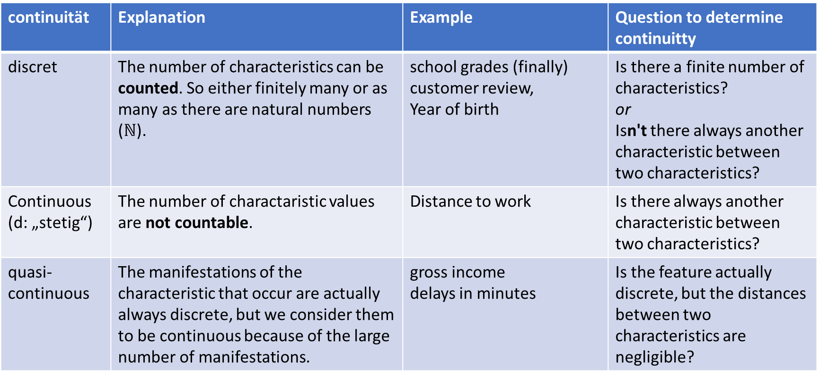
continuity of variables
19.99 20.00
continuität | Explanation | Example | Question to determine continuitty
discret | The number of characteristics can be counted. So either finitely many or as many as there are natural numbers ($ℕ$). | school grades (finally) customer review, Year of birth | Is there a finite number of characteristics? or Isn't there always another characteristic between two characteristics?
Continuous (d: „stetig“) | The number of charactaristic values are not countable. | Distance to work | Is there always another characteristic between two characteristics?
quasi-continuous | The manifestations of the characteristic that occur are actually always discrete, but we consider them to be continuous because of the large number of manifestations. | gross income delays in minutes | Is the feature actually discrete, but the distances between two characteristics are negligible?

Slide 33
Important data types in pandas
Datentyp | Bedeutung | Skalierung | Kontinuität
int64 | Integer with 64-Bit | ratio (except division) | discret
float64 | floating point numbers with 64-Bit | ratio | quasi-continous
object | can contain everything (default when reading strings) | ordinal (alphabetisch) | discret
string | strings | ordinal (alphabetisch) | discret
bool | boolean (True or False) | ordinal (False < True, because: 0 < 1) | discret
datetime64[ns] | Dates and time in nanosec. | interval | quasi-continous
timedelta[ns] | timedifference in nanosek. | ratio | quasi-continous
category | Optimized data type for finite nominal or ordinal data | nominal or ordinal | discret

Slide 34


Positional Parameters / Central Tendancy
Let $X≔(x_{1},x_{2},…,x_{n})$ be a tupel of observations.
Let $f_{h}\left(x\right)$ the frequency of occurrence of $x$ in $X$.
Let $\left(x_{\left[1\right]},x_{\left[2\right]},…,x_{\left[n\right]}\right)$ be the sorted tuple of all observations.
Name | meaning | formula | Methode in pandas | required scale
mode | value that appears most commonly | $${\overline{x}}_{Mod}≔\underset{x∈X}{argmax}{f_{h}\left(x\right)}$$ | mode | nominal
median | value that lies in the middle of the sorted dataset. | $${\overline{x}}_{Z}≔\left\{\begin{aligned}x_{\left[\frac{n+1}{2}\right]} , für ungerades n \\ \frac{1}{2}\left(x_{\left[\frac{n}{2}\right]}+x_{\left[\frac{n}{2}+1\right]}\right) ,sonst\end{aligned}\right.$$ | median | ordinal
arithmetic mean | average of all valuues | $$\overline{x}≔\frac{1}{n}\sum_{i=1}^{n}{x_{i}}=\frac{x_{1}+x_{2}+…+x_{n}}{n}$$ | mean | metric
geometric mean | average increment factor | $${\overline{x}}_{g}≔ \sqrt[n]{\prod_{i=1}^{n}{x_{i}}}=\sqrt[n]{x_{1}⋅x_{2}⋅…⋅x_{3}}$$ | gmean (scipy) | ratio and $X$ must consist of increment factors
harmonic mean | average ratio | $${\overline{x}}_{h}≔\frac{n}{\sum_{i=1}^{n}{\frac{1}{x_{i}}}}$$ | hmean (scipy) | ratio und $X$ must be ratios (z.B. km/h)
Notes:
Positional Parameters / Central Tendancy

Slide 35











Feature carrier
feature: size
characteristics
$$\begin{matrix}X & := & ( & x_{1} & , & x_{2} & , & x_{3} & , & x_{4} & , & x_{5} & , & x_{6} & , & x_{7} & ) \\ & = & ( & 106 & , & 30 & , & 84 & , & 35 & , & 30 & , & 30 & , & 84 & )\end{matrix}$$
Sorted values:
$$x_{1}→x_{\left[7\right]}, x_{2}→x_{\left[1\right]},…$$
Sorted characteristics
$$\begin{matrix} & & ( & x_{\left[1\right]} & , & x_{\left[2\right]} & , & x_{\left[3\right]} & , & x_{\left[4\right]} & , & x_{\left[5\right]} & , & x_{\left[6\right]} & , & x_{\left[7\right]} & ) \\ & = & ( & 30 & , & 30 & , & 30 & , & 35 & , & 84 & , & 84 & , & 106 & )\end{matrix}$$
modus
$${\overline{x}}_{Mod}=30$$
median
$${\overline{x}}_{Z}=x_{\left[\frac{7+1}{2}\right]}=x_{\left[4\right]}=35$$
arithmetic mean
$$\overline{x}=\frac{30+30+30+35+84+84+106}{7}=\frac{399}{7}=57$$

Slide 36

spreads
spreads | Explanation | formula | method in pandas | needed scaling
range | Difference between smallest and largest value. | $$R≔x_{\left[n\right]}−x_{\left[1\right]}$$ | max $−$ min | metric
varianz | The arithmetic mean of the square deviations from the mean. | $$σ_{ }^{2}≔\frac{1}{n}\sum_{i=1}^{n}{{\left(x_{i}−\overline{x}\right)}^{2}}$$ | var | metric
standard deviation | Squareroot of the variance | $$σ_{ }≔\sqrt{σ^{2}}$$ | std | metric
percentile | A quantile for a given percentage value $p∈\left[0,1\right]$ is the characteristic value, so that the $p$-percent of the characteristic values have this size at most | There are different ways to calculate quantiles (parameter: interpolation) | quantile | ordinal
Notes:
Scattering Measurements

Slide 37
Getting an overview
The describe and info methods provide a quick overview of the mean values and spreads of the metrically scaled characteristics.
To see the others as well, they can be included with the include parameter.
The data types can be queried using the dtypes field.
Notes:
import pandas as pd
df = pd.DataFrame(
{'A': [1, 2, 3, 4, 5],
'B': [1.1, 2.2, 3.3, 4.4, 5.5],
'C': ['a', 'b', 'c', 'z', 'e'],
'D': [True, False, True, False, True],
'E': pd.to_datetime(['2021-01-01',
'2021-02-01',
'2021-03-01',
'2021-04-01',
'2021-05-01'])})

Slide 38

Supervised Learning
Generic term for machine learning methods that recognizes patterns and connections based on examples. Goal: inference.
We need to give the model labeled examples so that it can later predict the labels for new examples.
Hund
Hund
Katze
Katze
???
Katze
Hund
Katze

Slide 39
Examples for supervised learning
fraud detection
image recognition
sales forecast
…
Notes:
Fraud Detection
Image Recognition
Sales forecast

Slide 40

Unsupervised Learning
Data is not labeled here, but the algorithm should find and define the labels.
Sometimes you can specify the number of clusters.
There are methods to determine the optimal number of clusters.
Find the clusters!

Slide 41


Slide 42
Unsupervised Learning
cluster analysis
Market basket analysis
Dimension reduction (reduce large amounts of data)
...
Notes:
(Shopping) Cart analysis
Dimansionality reduction

Slide 43
Train-Test-Split
All Data
When we train a model for inference we split the data into train and testing data.
sklearn: train_test_split
The model is only trained with training data.
Split test=0.25
Train
Test

Slide 44
Stratify
All Data
The training data needs to be a good representation of the whole dataset. If the labels are very uneven we can use the parameter „stratify“.
Split test=0.25
stratify by color
Ratio of green to blue is equal in both sets.
Train
Test

Slide 45
Cross validation
In Corrs validation we train multiple models with the same parameters.
M
P1, P2
M
P1, P2
M
P1, P2
All Data
Train and Validation for model 1
Train and Validation for model 2
Train and Validation for model 3
Test

Slide 46
k-nearest Neighbor Algorithm (kNN)
kNN is a supervised Algorithm for Classification or Regression.
Intuition: We decide the target-value of a new sample by taking a majority vote of it‘s k nearest neighbors.

Slide 47

Labeled Dataset
Assume we have a labeled Dataset of blue and green points.
The features are the x and y coordinates and the target is the color of the point.

Slide 48

New Sample
How should a new sample A be colored?

Slide 49

Prediction
We look for the k=5 closest points of A.
We color A the like the majority of these nearest seighbors.

Slide 50

Questions
How to choose k?
Common answer: $k≔\sqrt{n}$, where $n$ are the number of samples.
What measurement is used for calculating distances?
There are different ways to define distances. (euclid, manhatten, …)
Do all neighbors have equal voting rights?
You can choose to weight the class of close neighbors higher than those of distant once.
How can we do regression with kNN?
Yes! (next slide)

Slide 51

Regression
If your target is numeric, you can formulate a prediction using kNN by taking the average of the k nearest neighbors.
Basically it‘s a form of interpolation.
This interpolation works better for new samples lying in the middle of the dataset.
Notes:
https://scikit-learn.org/stable/auto_examples/neighbors/plot_regression.html

Slide 52

Implementation in scikit-learn
scikit-learn implements KNN in the class KNeighborsClassifier.
For regression use KNeighborsRegressor.
Beispiel: https://www.kaggle.com/viktorreichert/knn-scaling-red-wine

Slide 53

Distances
Whenever we speak of „neighbours“, „far“, „close“ etc. we implicitly refer to distances.
But there are a lot of valid definitions for distances.
E.g.: How can you calculate the distance between the two power outlets?

Slide 54


Distances
Manhatten distance: You measure the distance along the wall.
Euclidian distance: You measure the distance as the crow flies.
The „correct“ distance ist dependent on the application. Both are valid ways to measure distances.

Slide 55

Distances in Chess
For a chess piece you can calculate the distance to every other field by counting the minimal number of moves it needs to get there.
2
2
1
2
2
2
2
2
2
2
2
2
2
2
3
2
3
2
3
2
3
4
2
2
1
2
2
2
2
2
2
2
2
2
2
2
4
1
2
1
4
3
2
3
2
2
1
2
2
2
2
2
2
2
2
2
2
2
1
2
3
2
1
2
3
4
1
1
0
1
1
1
1
1
2
3
0
3
2
3
2
3
2
2
1
2
2
2
2
2
2
2
2
2
2
2
2
1
2
3
2
1
2
3
4
2
2
1
2
2
2
2
2
2
2
2
2
2
2
2
4
1
2
1
4
3
2
3
2
2
1
2
2
2
2
2
2
2
2
2
2
2
3
2
3
2
3
2
3
4
2
2
2
1
2
2
2
2
2
2
2
1
2
2
2
2
2
2
3
2
3
2
3
4
3
Rook
Knight

Slide 56

What is a distance?
If you have a set $M$ of elements you want to define a pairwise distance for, you can do so as follows:
Let $d:M×M→ℝ$ be a function. $d$ defines a distance on $M$ if and only if:
Shorthand | Formula | Explanation
Staying costs nothing | $$∀x∈M:$$ $$d\left(x,x\right)=0$$ | You don‘t need to traverse any distance if you want to end in the same point you started from.
Distance is directionless | $$∀x,y∈M:$$ $$d\left(x,y\right)=d(y,x)$$ | Calculating the distance of from $x$ to $y$ yields the same as calculating it from $y$ to $x$.
No different Points live in the same spot | $$∀x,y∈M:$$ $$x≠y⇒d\left(x,y\right)>0$$ | There must always be a positive distance between different points
No Shortcuts allowed | $$∀x,y,z∈M:$$ $$d\left(x,z\right)≤d\left(x,y\right)+d\left(y,z\right)$$ | $d$ always discribes the length of the shortest path between two elements $x$ and $z$.If you traverse over another point $y$ on your way from $x$ to $z$ the sum of distances will not be shorter.
y
x
z

Slide 57


Different Distances (1)
Let $a,b∈ℝ^{n}$ be Points of dimension $n$.
So: $a=\left(a_{1},a_{2},…,a_{n}\right)$ and $b=\left(b_{1},b_{2},…,b_{n}\right)$.
Name | Formula | Description
Euclid (L2) | $$d^{ED}\left(a,b\right)=\sqrt{\sum_{i=1}^{n}{{(a_{i}−b_{i})}^{2}}}$$ | As the crow flies.
Euclid squared (L2 squared) | $$d^{EQD}\left(a,b\right)=\sum_{i=1}^{n}{{(a_{i}−b_{i})}^{2}}$$ | As the crow flies squared. This means a double distance in normal euclid translates to a quadrupled distance in Euclid squared.
Manhatten (City-Block, Taxi Cab, L1) | $$d^{CB}\left(a,b\right)=\sum_{i=1}^{n}{{\left|a_{i}−b_{i}\right|}^{ }}$$ | Only move along the axis to calculate the distance.
Tschebyscheff | $$d^{TB}\left(a,b\right)=\max_{i=1}^{n}⁡(\left|a_{i}−b_{i}\right|\text{)}$$ | Only pick the longest distance along an axis while using Manhatten.

Slide 58

Different Distances (2)
Let $a,b∈ℝ^{n}$ be Points of dimension $n$.
So: $a=\left(a_{1},a_{2},…,a_{n}\right)$ and $b=\left(b_{1},b_{2},…,b_{n}\right)$.
Name | Formula | Description
Minkowski (LP) | $$d_{p}^{MI}\left(a,b\right)={\left(\sum_{i=1}^{n}{{{\left|a_{i}−b_{i}\right|}^{p}}^{ }}\right)}^{\frac{1}{p}}$$ $$p∈[1,∞)$$ | Family of distances. Each $p$ describes a different distance. If you choose $p=1$ you get the Manhatten distance. $p=2$ is Euclid.
Mahalanobis | $$d^{MA}\left(a,b\right)=\sqrt{{(a−b)}^{t}S^{−1}(a−b)}$$ Where $S∈ℝ^{n×n}$ is the covariancematrix of the axis based on all datapoints. | Calculates distances based on the distribution of the Elements.

Slide 59

Regression
In regression, a simple function (e.g., a straight line) is calculated to estimate the target (y-axis) as accurately as possible based on the features (x-axis).
Visualisation from Yi Zhe.
Notes:
https://observablehq.com/@yizhe-ang/interactive-visualization-of-linear-regression

Slide 60


What does optimal mean?
Let $\left\{\left(x_{1},y_{1}\right), \left(x_{2},y_{2}\right),…, \left(x_{n},y_{n}\right)\right\}=\left(X,y\right)$ be pairs of features and targets.
$f$ is a regression function (according to the method of least squares) if the squared error $MSE=\sum_{i=1}^{n}{{\left(y_{i}−f\left(x_{i}\right)\right)}^{2}}$ is minimized.
There is no other function of this kind (e.g., linear) in which smaller squared errors occur.
Why squares? It is because larger deviations are penalized extremely strongly, while smaller ones are hardly penalized. (A deviation twice as large is weighted four times as strongly).
double the side length
Notes:
https://observablehq.com/@yizhe-ang/interactive-visualization-of-linear-regression

Slide 61

Calculations
A regression line can indeed be calculated directly and does not need to be approximated.
The goal is to find a function of the form $\hat{y}≔ f\left(x\right)=a+b⋅x$ that minimizes the error function:
$$MSE=\sum_{i=1}^{n}{{\left(y_{i}−f\left(x_{i}\right)\right)}^{2}}=\sum_{i=1}^{n}{{\left(y_{i}−\left(a+b⋅x_{i}\right)\right)}^{2}}$$
The minimum is located at the zero-crossing of the derivative! So, let's calculate it:
$$\frac{∂MSE}{∂a}=\sum_{i=1}^{n}{2\left(y_{i}−a−bx_{i}\right)⋅\left(−1\right)}\overset{!}{=}0$$
$$\frac{∂MSE}{∂b}=\sum_{i=1}^{n}{2\left(y_{i}−a−bx_{i}\right)⋅\left(−x_{i}\right)}\overset{!}{=}0$$

Slide 62

We can further rearrange this equation:
$$\left(\sum_{i=1}^{n}{−y_{i}}\right)+\left(\sum_{i=1}^{n}{a}\right)+\left(\sum_{i=1}^{n}{bx_{i}}\right)=0$$
$$\left(\sum_{i=1}^{n}{−y_{i}}x_{i}\right)+\left(\sum_{i=1}^{n}{a}x_{i}\right)+\left(\sum_{i=1}^{n}{bx_{i}^{2}}\right)=0$$
We can rearrange further:
$$na+b\sum_{i=1}^{n}{x_{i}}=\sum_{i=1}^{n}{y_{i}}$$
$$a\sum_{i=1}^{n}{x_{i}}+b\sum_{i=1}^{n}{x_{i}^{2}}=\sum_{i=1}^{n}{y_{i}}x_{i}$$
We can write this as a matrix multiplication:
$$\left(\begin{matrix}n & \sum_{i=1}^{n}{x_{i}} \\ \sum_{i=1}^{n}{x_{i}} & \sum_{i=1}^{n}{x_{i}^{2}}\end{matrix}\right)\left(\begin{aligned}a \\ b\end{aligned}\right)=\left(\begin{aligned}\sum_{i=1}^{n}{y_{i}} \\ \sum_{i=1}^{n}{y_{i}x_{i}}\end{aligned}\right)$$
Finally we can write all as vectors:
$$\left(\begin{aligned}1 \\ X\end{aligned}\right){\left(\begin{aligned}1 \\ X\end{aligned}\right)}^{t}\left(\begin{aligned}a \\ b\end{aligned}\right)=\left(\begin{aligned}1 \\ X\end{aligned}\right)⋅y$$
We have translated the problem into a system of linear equations, which can be easily solved (for example, using the Gaussian algorithm). Note that $a$ and $b$ are the unknowns. Everytthing else is given a part of the dataset.

Slide 63

Alternative calculation methods
There are also other ways to determine the regression line.
One can calculate the slope as the quotient of the covariance and the variance of the feature: $b=\frac{s_{Xy}}{s_{X}^{2}}$
The y-intercept can be calculated using the arithmetic means of $x$ and $y$ as follows: $a=\overline{y}−b\overline{X}$
However, the previous form can easily be generalized for multivariate regression (i.e. multiple features $X^{\left(1\right)},X^{\left(2\right)},…$ Beispiel)
Notes:
https://www.geogebra.org/calculator/j4prtdbq

Slide 64

statistical metrics for regression
Name | Formel | Erklärung | Methode in Numpy
Covarianz | $$σ_{xy}≔\frac{1}{n}\sum_{i=1}^{n}{(x_{i}−\overline{x})(y_{i}−\overline{y})}∈ℝ$$ | Link with detailed explanation | cov with bias=False
correlation coefficient | $$r≔\frac{σ_{xy}}{σ_{x}⋅σ_{y}}∈[−1,1]$$ | The closer $r$ is to $1$ or $−1$, the better the values are on a straight line. The sign of $R$ correspponds to the sign of the slope of the regression line. | corrcoeff
coefficient of determination | $$R^{2}≔R_{y\hat{y}}^{2}≔\frac{σ_{\hat{y}}^{2}}{σ_{y}^{2}}∈[0,1]$$ | Normaly, if $R^{2}>0,8$ there is a usable regression. For linear regression $r^{2}=R^{2}$. | LinearRegression.score
Notes:
https://www.kaggle.com/code/viktorreichert/tutorial-visualization-of-covariance-and-variance

Slide 65





Linear function
Linear funciton have the form
$$\hat{y}=f\left(x\right)=b+a⋅x$$
We use the previous derived formula:
$$\left(\begin{aligned}1 \\ X\end{aligned}\right){\left(\begin{aligned}1 \\ X\end{aligned}\right)}^{t}\left(\begin{aligned}a \\ b\end{aligned}\right)=\left(\begin{aligned}1 \\ X\end{aligned}\right)⋅y$$
1
0,5
1,7
3,2
..
4
$$x$$ | $$y$$
0,5 | 65,2
1,7 | 42,7
3,2 | 39,4
4,7 | 19,6
6,3 | 12,4
4 | 6
$$\hat{y}$$
58,088792
46,8313609
32,7595719
18,6877829
3,67787462
25,2546177
$$a=−9,38$$
$$b=62,78$$
$$\hat{y}=f\left(x\right)=62,78−9,38⋅x$$
regression
predict
evaluate
$$R^{2}=0,776$$

Slide 66


Other types of regression, traceable to linear regression
Many other types of regression can be reduced to linear regression by transforming the inputs or targets.
Notice that the coeefficient of determination is then $R_{y\hat{y}}^{2}≠r_{xy}^{2}$.

Slide 67







Exponential function
Exponential functions have the form
$$\hat{y}=f\left(x\right)=b⋅a^{x}$$
We get a linear function by taking the logarithm of the equation:
$$ln\left(\hat{y}\right)=ln\left(b⋅a^{x}\right)=ln\left(b\right)+x⋅ln\left(a\right)$$
$$x$$ | $$y$$
27 | 350
24 | 215
14 | 42
32 | 1210
29 | 630
12 | 10
20 | 73
33 | 1525
25 | 230
22 | 155
18 | 65
31 | 980
$$x$$
27
24
14
32
29
12
20
33
25
22
18
31
$$ln\left(y\right)$$
5,85793315
5,37063803
3,73766962
7,09837564
6,44571982
2,30258509
4,29045944
7,32974969
5,43807931
5,04342512
4,17438727
6,88755257
$$\ln\left(b\right)=0,166$$
$$⇒e^{\ln\left(b\right)}=b=1,18$$
$$\ln\left(a\right)=0,216$$
$$⇒e^{\ln\left(a\right)}=a=1,233$$
$$\hat{y}=f\left(x\right)=0,18⋅{1,233}^{x}$$
$$\hat{y}$$
402,351993
210,477713
24,277613
1184,69409
619,735227
15,7618052
88,7168398
1470,30094
261,219822
136,648884
57,5978187
954,566545
transform $y$
regression
predict

Slide 68





Calculate $R^{2}$
We examine the quality of $\hat{y}$ by performing a linear regression on $y$ and $\hat{y}$. The coefficient of determination $R^{2}$ of the original regression is the same as thecorrelation coefficient of this new linear regression: $R^{2}=r_{y\hat{y}}^{2}$.
In case of a perfect match of $y$ and $\hat{y}$ the regression line line lies exactly on the diagonal $y↦y$.
$$y$$
350
215
42
1210
630
10
73
1525
230
155
65
980
$$\hat{y}$$
402,351993
210,477713
24,277613
1184,69409
619,735227
15,7618052
88,7168398
1470,30094
261,219822
136,648884
57,5978187
954,566545
evaluate
$$R^{2}=0,997$$

Slide 69



Residual plot
The residual plot, chich compares $x$ with the residuals $y−\hat{y}$ , is also often examined.
If this results in an evenly distributed point cloud, everything is usually fine.
$$x$$
27
24
14
32
29
12
20
33
25
22
18
31
$$y−\hat{y}$$
350
215
42
1210
630
10
73
1525
230
155
65
980

Slide 70

Expanding existing models
It may be a good idea to expand an existing implementation of a model instead of building it from scratch.
In this way, the functionalities are adopted that do not have to be adapted at all.
Notes:
inheriting

Slide 71






Power function
Power functions have the form
$$\hat{y}=f\left(x\right)=b⋅x^{a}$$
We get a linear function by taking the logarithm of the equation:
$$ln\left(\hat{y}\right)=ln\left(b⋅x^{a}\right)=ln\left(b\right)+a⋅ln\left(x\right)$$
$$x$$ | $$y$$
30 | 100
25 | 200
20 | 240
18 | 300
15 | 400
10 | 600
5 | 1000
1 | 5000
$$ln\left(x\right)$$ | $$ln\left(y\right)$$
3,4 | 4,61
3,22 | 5,3
3 | 5,48
2,89 | 5,7
2,71 | 5,99
2,3 | 6,4
1,61 | 6,91
0 | 8,52
$$\hat{y}$$
155,88
188,86
238,86
266,88
323,34
495,46
1027,72
5592,58
$$\ln\left(b\right)=−1,05$$
$$⇒e^{\ln\left(b\right)}=b=5592,57$$
$$a=−1,05$$
$$\hat{y}=f\left(x\right)=5592,57⋅x^{−1,05}$$
transform
regression
predict
evaluate
$$R^{2}=0,998$$
Notes:
Power function

Slide 72






Polynomial function
Polynomial function of degree 2:
$$\hat{y}=f\left(x\right)=a+bx^{ }+cx^{2}$$
We get the equation by expanding the calculation path from above in the following way:
$${\left(\begin{matrix}1 \\ x^{ } \\ x^{2}\end{matrix}\right)}^{ }⋅y={\left(\begin{matrix}1 \\ x^{ } \\ x^{2}\end{matrix}\right)}^{ }⋅{\left(\begin{matrix}1 \\ x^{ } \\ x^{2}\end{matrix}\right)}^{t}⋅\left(\begin{matrix}a \\ b \\ c\end{matrix}\right)$$
$$x$$ | $$y$$
15 | 1800
30 | 3600
45 | 6840
60 | 7200
75 | 8100
90 | 8460
105 | 8640
120 | 9000
135 | 9180
150 | 9000
165 | 8640
180 | 8460
195 | 8100
210 | 7740
$$x^{2}$$
225
900
2025
3600
5625
8100
11025
14400
18225
22500
27225
32400
38025
44100
$$\hat{y}$$
2626,07
4171,4
5517,2
6663,46
7610,19
8357,39
8905,05
9253,19
9401,79
9350,85
9100,38
8650,38
8000,85
7151,79
$$a=881,20$$
$$b=122,96$$
$$c=−0,443$$
$$\hat{y}=f\left(x\right)=881,2+122,96x−0,443x^{2}$$
transform
regression
predict
evaluate
$$R^{2}=0,93$$

Slide 73







Logistic Function
Logistic functions have the form
$$\hat{y}=f\left(x\right)=\frac{k}{1+e^{a⋅x+b}}$$
where $k∈ℝ_{+}$ ist the highest possible value of $\hat{y}$ (hyperparamter).
After conversion we get:
$$ln\left(\frac{k}{\hat{y}}−1\right)=a⋅x+b$$
$$ln\left(\frac{k}{y}−1\right)$$
4,22
3,56
2,57
2,12
1,52
1,03
0,46
-0,11
-0,68
-1,22
-1,67
-2,14
-2,87
-3,28
-3,85
-4,28
-4,81
-5,33
$$x$$ | $$y$$
1 | 9,6
2 | 18,3
3 | 47,2
4 | 71,1
5 | 119,1
6 | 174,6
7 | 257,3
8 | 350,7
9 | 441
10 | 513,3
11 | 559,7
12 | 594,8
13 | 629,4
14 | 640,8
15 | 651,1
16 | 655,9
17 | 659,6
18 | 661,8
$$\hat{y}$$
13,94
23,76
40,08
66,43
107,15
165,9
242,83
331,74
420,75
497,96
557,03
598,02
624,57
641,02
650,93
656,8
660,24
662,24
$$k=665$$
transform
$$a=−0,55$$
$$b=4,39$$
$$\hat{y}=f\left(x\right)=\frac{665}{1+e^{−0,55⋅x+4,39}}$$
regression
predict
evaluate
$$R^{2}=0,998$$

Slide 74

Logistic regression
Calcualation way:
$$\begin{matrix} & \hat{y}=\frac{k}{1+e^{a⋅x+b}} \\ ⇔ & \frac{\hat{y}}{k}=\frac{1}{1+e^{a⋅x+b}} \\ ⇔ & \frac{k}{\hat{y}}=1+e^{a⋅x+b} \\ ⇔ & \frac{k}{\hat{y}}−1=e^{a⋅x+b} \\ ⇔ & ln\left(\frac{k}{\hat{y}}−1\right)=a⋅x+b\end{matrix}$$

Slide 75

Other…
Other regressionstyps can be lead back to linear regression:
Polynomials of higher degree: $\hat{y}=a_{n}x^{n}+a_{n−1}x^{n−1}+…+a_{1}x+a_{0}$
Hyperbel $\left(\hat{y}=\frac{a}{x}+b\right)$
Logarithm $\left(\hat{y}=a⋅ln\left(x\right)+b \right)$
…

Slide 76

Example
Notebook with extensive example for linear and exponential regression.
Notes:
https://www.kaggle.com/code/viktorreichert/exponantial-regression-geometric-mean-fast-imp

Slide 77

Naive Bayes classifier
The main idea of this classifier is to use Bayes theorem:
$$P\left(A | B\right)=\frac{P\left(B | A\right)⋅P\left(A\right)}{P\left(B\right)}$$
$P\left(A\right)$ Propabilty of event $A$.
$P\left(B\right)$ Propabilty of event $B$.
$P\left(A | B\right)$ Propabilty of event $A$ given $B$.
$P\left(B | A\right)$ Propabilty of event $B$ given $A$.

Slide 78




Example Data
Assume we have a lot of cats $C$ and dogs $\overline{C}$ with either white $W$ and black $\overline{W}$ fur.
 | Cat $$C$$ | Dog $$\overline{C}$$ | Sum
White fur $$W$$ | 1 | 4 | 5
Black fur $$\overline{W}$$ | 3 | 2 | 5
Sum | 4 | 6 | 10

Slide 79

Contingency table
We can sort the data as propabilities in a contingency table
 | Cat $$C$$ | Dog $$\overline{C}$$ | Sum
White fur $$W$$ | $$P\left(W∩C\right)=0.1$$ | $$P\left(W∩\overline{C}\right)=0.4$$ | $$P\left(W\right)=0.5$$
Black fur $$\overline{W}$$ | $$P\left(\overline{W}∩C\right)=0.3$$ | $$P\left(\overline{W}∩\overline{C}\right)=0.2$$ | $$P\left(\overline{W}\right)=0.5$$
Sum | $$P\left(C\right)=0.4$$ | $$P\left(\overline{C}\right)=0.6$$ | $$P\left(Ω\right)=1$$

Slide 80
























Propability tree
$$W$$
$$P\left(W | C\right)=0.25$$
$$C$$
$$P\left(C\right)=0.4$$
$$P\left(\overline{W} | C\right)=0.75$$
$$\overline{W}$$
Another way to visualize the data is a propabality tree
$$W$$
$$P\left(W | \overline{C}\right)=0.\overline{6}$$
$$P\left(\overline{C}\right)=0.6$$
$$\overline{C}$$
$$P\left(\overline{B} | \overline{C}\right)=0.\overline{3}$$
$$\overline{W}$$
$$C$$
$$P\left(C | W\right)=0.2$$
$$W$$
$$P\left(W\right)=0.5$$
$$P\left(\overline{C} | W\right)=0.8$$
$$\overline{C}$$
$$C$$
$$P\left(\overline{W}\right)=0.5$$
$$P\left(C | \overline{W}\right)=0.6$$
$$\overline{W}$$
$$P\left(\overline{C} | \overline{W}\right)=0.4$$
$$\overline{C}$$

Slide 81












Propability tree
$$W$$
$$P\left(W | C\right)=0.25$$
$$C$$
$$P\left(C\right)=0.4$$
$$P\left(\overline{W} | C\right)=0.75$$
$$\overline{W}$$
Another way to visualize the data is a propabality tree
$$W$$
$$P\left(W | \overline{C}\right)=0.\overline{6}$$
$$P\left(\overline{C}\right)=0.6$$
$$\overline{C}$$
$$P\left(\overline{B} | \overline{C}\right)=0.\overline{3}$$
$$\overline{W}$$
$$C$$
$$P\left(C | W\right)=0.2$$
$$W$$
$$P\left(W\right)=0.5$$
$$P\left(\overline{C} | W\right)=0.8$$
$$\overline{C}$$
$$C$$
$$P\left(\overline{W}\right)=0.5$$
$$P\left(C | \overline{W}\right)=0.6$$
$$\overline{W}$$
$$P\left(\overline{C} | \overline{W}\right)=0.4$$
$$\overline{C}$$

Slide 82



Difference between $P\left(A | B\right)$ and $P\left(A∩B\right)$
$P\left(A∩B\right)$ gives the propability that $A$ and $B$ accure.
$P\left(A | B\right)$ gives the propability that $A$ accures then $B$ already accured, i.e. is known to be true.
Probality for being a cat and having white fur:
$$P\left(C∩W\right)=0.1$$
Probalitlity for a cat to have white fur:
$$P\left(W | C\right)=0.25$$
Probality for a white fured animal to be a cat:
$$P\left(C | W\right)=0.2$$

Slide 83

All propabilities
$$W$$
$$P\left(W | C\right)=0.25$$
$$C$$
$$P\left(C\right)=0.4$$
$$P\left(\overline{W} | C\right)=0.75$$
$$\overline{W}$$
Although this seem to be overwhelmingly many probalities, things aren‘t so complicated.
There are a lot of different connections between the different probalitities.
$$W$$
$$P\left(W | \overline{C}\right)=0.\overline{6}$$
$$P\left(\overline{C}\right)=0.6$$
$$\overline{C}$$
$$P\left(\overline{B} | \overline{C}\right)=0.\overline{3}$$
$$\overline{W}$$
 | Cat $$C$$ | Dog $$\overline{C}$$ | Sum
White fur $$W$$ | $$P\left(W∩C\right)=0.1$$ | $$P\left(W∩\overline{C}\right)=0.4$$ | $$P\left(W\right)=0.5$$
Black fur $$\overline{W}$$ | $$P\left(\overline{W}∩C\right)=0.3$$ | $$P\left(\overline{W}∩\overline{C}\right)=0.2$$ | $$P\left(\overline{W}\right)=0.5$$
Sum | $P\left(C\right)=0.$4 | $$P\left(\overline{C}\right)=0.6$$ | $$P\left(Ω\right)=1$$
$$C$$
$$P\left(C | W\right)=0.2$$
$$W$$
$$P\left(W\right)=0.5$$
$$P\left(\overline{C} | W\right)=0.8$$
$$\overline{C}$$
$$C$$
$$P\left(\overline{W}\right)=0.5$$
$$P\left(C | \overline{W}\right)=0.6$$
$$\overline{W}$$
$$P\left(\overline{C} | \overline{W}\right)=0.4$$
$$\overline{C}$$

Slide 84














Complimentary rule
$$W$$
$$P\left(W | C\right)=0.25$$
$$C$$
$$P\left(C\right)=0.4$$
$$P\left(\overline{W} | C\right)=0.75$$
$$\overline{W}$$
$P\left(A\right)=1−P\left(\overline{A}\right)$
$1=P\left(A\right)+P\left(\overline{A}\right)$
$$W$$
$$P\left(W | \overline{C}\right)=0.\overline{6}$$
$$P\left(\overline{C}\right)=0.6$$
$$\overline{C}$$
$$P\left(\overline{B} | \overline{C}\right)=0.\overline{3}$$
$$\overline{W}$$
 | Cat $$C$$ | Dog $$\overline{C}$$ | Sum
White fur $$W$$ | $$P\left(W∩C\right)=0.1$$ | $$P\left(W∩\overline{C}\right)=0.4$$ | $$P\left(W\right)=0.5$$
Black fur $$\overline{W}$$ | $$P\left(\overline{W}∩C\right)=0.3$$ | $$P\left(\overline{W}∩\overline{C}\right)=0.2$$ | $$P\left(\overline{W}\right)=0.5$$
Sum | $P\left(C\right)=0.$4 | $$P\left(\overline{C}\right)=0.6$$ | $$P\left(Ω\right)=1$$
$$C$$
$$P\left(C | W\right)=0.2$$
$$W$$
$$P\left(W\right)=0.5$$
$$P\left(\overline{C} | W\right)=0.8$$
$$\overline{C}$$
$$C$$
$$P\left(\overline{W}\right)=0.5$$
$$P\left(C | \overline{W}\right)=0.6$$
$$\overline{W}$$
$$P\left(\overline{C} | \overline{W}\right)=0.4$$
$$\overline{C}$$

Slide 85




Addition rule
$$W$$
$$P\left(W | C\right)=0.25$$
$$C$$
$$P\left(C\right)=0.4$$
$$P\left(\overline{W} | C\right)=0.75$$
$$\overline{W}$$
$P\left(A\right)=P\left(A∩B\right)+P\left(A∩\overline{B}\right)$
$1=P\left(Ω\right)=P\left(A\right)+P\left(\overline{A}\right)$
$$W$$
$$P\left(W | \overline{C}\right)=0.\overline{6}$$
$$P\left(\overline{C}\right)=0.6$$
$$\overline{C}$$
Kunden, die Männer und zufrieden sind: 30% $P(M∩Z)$
Kunden, die Frauen und zufrieden sind: 40% $P(\overline{M}∩Z)$
Kunden, die zufrieden sind: 70% $P(Z)$
$$P\left(\overline{B} | \overline{C}\right)=0.\overline{3}$$
$$\overline{W}$$
 | Cat $$C$$ | Dog $$\overline{C}$$ | Sum
White fur $$W$$ | $$P\left(W∩C\right)=0.1$$ | $$P\left(W∩\overline{C}\right)=0.4$$ | $$P\left(W\right)=0.5$$
Black fur $$\overline{W}$$ | $$P\left(\overline{W}∩C\right)=0.3$$ | $$P\left(\overline{W}∩\overline{C}\right)=0.2$$ | $$P\left(\overline{W}\right)=0.5$$
Sum | $P\left(C\right)=0.$4 | $$P\left(\overline{C}\right)=0.6$$ | $$P\left(Ω\right)=1$$
$$C$$
$$P\left(C | W\right)=0.2$$
$$W$$
$$P\left(W\right)=0.5$$
$P\left(\overline{C} | W\right)=0.$8
$$\overline{C}$$
$$C$$
$$P\left(\overline{W}\right)=0.5$$
$$P\left(C | \overline{W}\right)=0.6$$
$$\overline{W}$$
$$P\left(\overline{C} | \overline{W}\right)=0.4$$
$$\overline{C}$$

Slide 86

Addition rule
$$W$$
$$P\left(W | C\right)=0.25$$
$$C$$
$$P\left(C\right)=0.4$$
$$P\left(\overline{W} | C\right)=0.75$$
$$\overline{W}$$
$P\left(A\right)=P\left(A∩B\right)+P\left(A∩\overline{B}\right)$
$1=P\left(Ω\right)=P\left(A\right)+P\left(\overline{A}\right)$
$$W$$
$$P\left(W | \overline{C}\right)=0.\overline{6}$$
$$P\left(\overline{C}\right)=0.6$$
$$\overline{C}$$
$$P\left(\overline{B} | \overline{C}\right)=0.\overline{3}$$
$$\overline{W}$$
 | Cat $$C$$ | Dog $$\overline{C}$$ | Sum
White fur $$W$$ | $$P\left(W∩C\right)=0.1$$ | $$P\left(W∩\overline{C}\right)=0.4$$ | $$P\left(W\right)=0.5$$
Black fur $$\overline{W}$$ | $$P\left(\overline{W}∩C\right)=0.3$$ | $$P\left(\overline{W}∩\overline{C}\right)=0.2$$ | $$P\left(\overline{W}\right)=0.5$$
Sum | $P\left(C\right)=0.$4 | $$P\left(\overline{C}\right)=0.6$$ | $$P\left(Ω\right)=1$$
$$C$$
$$P\left(C | W\right)=0.2$$
$$W$$
$$P\left(W\right)=0.5$$
$$P\left(\overline{C} | W\right)=0.8$$
$$\overline{C}$$
$$C$$
$$P\left(\overline{W}\right)=0.5$$
$$P\left(C | \overline{W}\right)=0.6$$
$$\overline{W}$$
$$P\left(\overline{C} | \overline{W}\right)=0.4$$
$$\overline{C}$$

Slide 87






Product rule
10 * 0.5 * 0.2
10 * 0.4 *0.25
$$W$$
$$P\left(W | C\right)=0.25$$
$$C$$
$$P\left(C\right)=0.4$$
$$P\left(\overline{W} | C\right)=0.75$$
$$\overline{W}$$
$P\left(A | B\right)⋅P\left(B\right)=P(A∩B)$
$P\left(B | A\right)⋅P\left(A\right)=P\left(A∩B\right)$
$P\left(B | A\right)⋅P\left(A\right)=$ $P\left(A | B\right)⋅P\left(B\right)$
$$W$$
$$P\left(W | \overline{C}\right)=0.\overline{6}$$
$$P\left(\overline{C}\right)=0.6$$
$$\overline{C}$$
$$P\left(\overline{B} | \overline{C}\right)=0.\overline{3}$$
$$\overline{W}$$
$$P\left(C\right)⋅P\left(W | C\right)=0.4⋅0.25=0.1=P(W∩C)$$
 | Cat $$C$$ | Dog $$\overline{C}$$ | Sum
White fur $$W$$ | $$P\left(W∩C\right)=0.1$$ | $$P\left(W∩\overline{C}\right)=0.4$$ | $$P\left(W\right)=0.5$$
Black fur $$\overline{W}$$ | $$P\left(\overline{W}∩C\right)=0.3$$ | $$P\left(\overline{W}∩\overline{C}\right)=0.2$$ | $$P\left(\overline{W}\right)=0.5$$
Sum | $P\left(C\right)=0.$4 | $$P\left(\overline{C}\right)=0.6$$ | $$P\left(Ω\right)=1$$
$$C$$
$$P\left(C | W\right)=0.2$$
$$W$$
$$P\left(W\right)⋅P\left(C | W\right)=0.5⋅0.2=0.1=P(W∩C)$$
$$P\left(W\right)=0.5$$
$$P\left(\overline{C} | W\right)=0.8$$
$$\overline{C}$$
$$C$$
$$P\left(\overline{W}\right)=0.5$$
$$P\left(C | \overline{W}\right)=0.6$$
$$\overline{W}$$
$$P\left(\overline{C} | \overline{W}\right)=0.4$$
$$\overline{C}$$

Slide 88



Bayes theorem
$$W$$
$$P\left(W | C\right)=0.25$$
$$C$$
$$P\left(C\right)=0.4$$
$$P\left(\overline{W} | C\right)=0.75$$
$$\overline{W}$$
$P\left(B | A\right)⋅P\left(A\right)=$ $P\left(A | B\right)⋅P\left(B\right)$
a/b= $\frac{a}{ b}$
$P\left(A | B\right)=\frac{P\left(A\right)⋅P\left(B | A\right)}{P\left(B\right)}$
$$W$$
$$P\left(W | \overline{C}\right)=0.\overline{6}$$
$$P\left(\overline{C}\right)=0.6$$
$$\overline{C}$$
$$P\left(\overline{B} | \overline{C}\right)=0.\overline{3}$$
$$\overline{W}$$
$$\frac{0.4⋅0.25}{0.5}=0.2$$
 | Cat $$C$$ | Dog $$\overline{C}$$ | Sum
White fur $$W$$ | $$P\left(W∩C\right)=0.1$$ | $$P\left(W∩\overline{C}\right)=0.4$$ | $$P\left(W\right)=0.5$$
Black fur $$\overline{W}$$ | $$P\left(\overline{W}∩C\right)=0.3$$ | $$P\left(\overline{W}∩\overline{C}\right)=0.2$$ | $$P\left(\overline{W}\right)=0.5$$
Sum | $P\left(C\right)=0.$4 | $$P\left(\overline{C}\right)=0.6$$ | $$P\left(Ω\right)=1$$
$$C$$
$$P\left(C | W\right)=0.2$$
$$W$$
$$P\left(W\right)=0.5$$
$$P\left(\overline{C} | W\right)=0.8$$
$$\overline{C}$$
$$C$$
$$P\left(\overline{W}\right)=0.5$$
$$P\left(C | \overline{W}\right)=0.6$$
$$\overline{W}$$
$$P\left(\overline{C} | \overline{W}\right)=0.4$$
$$\overline{C}$$

Slide 89



Bayes theorem
$$W$$
$$P\left(W | C\right)=0.25$$
$$C$$
$$P\left(C\right)=0.4$$
$$P\left(\overline{W} | C\right)=0.75$$
$$\overline{W}$$
$P\left(A | B\right)=\frac{P\left(A\right)⋅P(B|A)}{P(B)}=\frac{P\left(A\right)⋅P(B|A)}{P\left(B∩A\right)+P\left(B∩\overline{A}\right)}$
=$\frac{P\left(A\right)⋅P\left(B | A\right)}{P\left(A\right)⋅P\left(B | A\right)+P\left(\overline{A}\right)⋅P\left(B | \overline{A}\right)}$
6=3+3=2*3
$$W$$
$$P\left(W | \overline{C}\right)=0.\overline{6}$$
$$P\left(\overline{C}\right)=0.6$$
$$\overline{C}$$
$$P\left(\overline{B} | \overline{C}\right)=0.\overline{3}$$
$$\overline{W}$$
$$\frac{0.4⋅0.25}{0.4⋅0.25+0.6⋅0.\overline{6}}=0.2$$
 | Cat $$C$$ | Dog $$\overline{C}$$ | Sum
White fur $$W$$ | $$P\left(W∩C\right)=0.1$$ | $$P\left(W∩\overline{C}\right)=0.4$$ | $$P\left(W\right)=0.5$$
Black fur $$\overline{W}$$ | $$P\left(\overline{W}∩C\right)=0.3$$ | $$P\left(\overline{W}∩\overline{C}\right)=0.2$$ | $$P\left(\overline{W}\right)=0.5$$
Sum | $P\left(C\right)=0.$4 | $$P\left(\overline{C}\right)=0.6$$ | $$P\left(Ω\right)=1$$
$$C$$
$$P\left(C | W\right)=0.2$$
$$W$$
$$P\left(W\right)=0.5$$
$$P\left(\overline{C} | W\right)=0.8$$
$$\overline{C}$$
$$C$$
$$P\left(\overline{W}\right)=0.5$$
$$P\left(C | \overline{W}\right)=0.6$$
$$\overline{W}$$
$$P\left(\overline{C} | \overline{W}\right)=0.4$$
$$\overline{C}$$

Slide 90






















Bayes theorem
$$T$$
$$P(T|K)=0.9$$
$$K$$
$$P\left(K\right)=0.0001$$
$$P(\overline{T}|K)=0.1$$
$P\left(K | T\right)=\frac{P\left(K\right)⋅P(T|K)}{P\left(T\right)}=\frac{P\left(K\right)⋅P(T|K)}{P\left(K\right)P\left(T | K\right)+P\left(\overline{K}\right)P(T|\overline{K})}=\frac{0.0001⋅0.9}{0.0001⋅0.9+0.9999⋅0.2}=0.00448$
$$\overline{T}$$
$$T$$
$$P\left(\overline{K}\right)=0,9999$$
$$\overline{K}$$
$$P(T|\overline{K})=0.2$$
$$P(\overline{T}|\overline{K})=0.98$$
$$\overline{T}$$
$$P\left(K | T\right)=0.00448$$
 | Cat $$K$$ | Dog $$\overline{K}$$ | Sum
White fur $$T$$ | $$P\left(K∩T\right)=$$ | $$P\left(K∩\overline{T}\right)=$$ | $$P\left(T\right)=$$
Black fur $$\overline{T}$$ | $$P\left(\overline{K}∩T\right)=$$ | $$P\left(\overline{K}∩\overline{T}\right)=$$ | $$P\left(\overline{T}\right)=$$
Sum | $$P\left(K\right)=$$ | $$P\left(\overline{K}\right)=$$ | $$P\left(Ω\right)=1$$
$$K$$
$$T$$
$$P\left(T\right)=0.20088$$
$$\overline{K}$$
$$K$$
$$\overline{T}$$
$$\overline{K}$$

Slide 91

Naive Bayes classifier
$$W$$
$$P\left(W | C\right)=0.25$$
$$C$$
$$P\left(C\right)=0.4$$
$$P\left(\overline{W} | C\right)=0.75$$
$$\overline{W}$$
Let‘s assume we new cat arrives.
With Bayes thorem we can calculate the propability that it has white fur:
$$P\left(W | C\right)=\frac{P\left(C | W\right)⋅P\left(C\right)}{P\left(W\right)}=\frac{0.4⋅0.25}{0.5}=0.2$$
$$W$$
$$P\left(W | \overline{C}\right)=0.\overline{6}$$
$$P\left(\overline{C}\right)=0.6$$
$$\overline{C}$$
$$P\left(\overline{B} | \overline{C}\right)=0.\overline{3}$$
$$\overline{W}$$
$$C$$
$$P\left(C | W\right)=0.2$$
$$W$$
$$P\left(W\right)=0.5$$
$$P\left(\overline{C} | W\right)=0.8$$
$$\overline{C}$$
$$C$$
$$P\left(\overline{W}\right)=0.5$$
$$P\left(C | \overline{W}\right)=0.6$$
$$\overline{W}$$
$$P\left(\overline{C} | \overline{W}\right)=0.4$$
$$\overline{C}$$

Slide 92







Independent variables
Two variables $A$ and $B$ are independent if $P\left(A | B\right)=P\left(A\right)$.
$$P\left(green\right)=\frac{12}{16}=\frac{6}{8}=P\left(green | big\right)$$
Being big does not change if you are green or not.
Color and Size are independent.
$$P\left(green\right)=\frac{12}{16}≠\frac{2}{4}=P\left(green | grasshopper\right)$$
There is a higher propability for being green as a grasshopper.
So color and species are dependent.
Found in
Backyard
Found in
Frontyard

Slide 93



Conditionally dependent
Let $A,B$ and $y$ be Events. $A$ and $B$ are conditionally independent on $y$ if $P\left(A | B∩y\right)=P\left(A | y\right)$.
We have seen that species and color are not independent.
$$P\left(green\right)=\frac{10}{16}≠\frac{2}{4}=P\left(green | grasshopper\right)$$
If we evaluate the same under the condition that only bugs from the Backyard are considered, we get:
$$P\left(green | backyard\right)=\frac{4}{8}=\frac{1}{2}=P\left(green | grasshopper∩backyard\right)$$
So species and color are independent under the condition „from backyard“.
We often write $P\left(A,B\right)$ instead of $P\left(A∩B\right)$.
So you might also see: $P\left(A | B,y\right)=P\left(A | y\right)$.
Found in
Backyard
Found in
Frontyard

Slide 94

Math of Naive Bayes classifier
We consider all features $x_{1}, …,x_{n}$ conditionally independent on $y$ from each other.
So: $P\left(x_{1} | y\right)=P\left(x_{1} | x_{2},y\right)=…=P\left(x_{1} | x_{2},x_{3},…,x_{n},y\right)$ and so on…
This is normally not the case for real data, but we ignore this. This is why the classifier ist called „naive“.
We use Bayes Theorem to calculate the Probability for a label based on given features:
$$P\left(y | x_{1},…,x_{n}\right)=\frac{P\left(y\right)P\left(x_{1},…,x_{n} | y\right)}{P(x_{1},…,x_{n})}$$
$$P\left(spam | Can, you, owe, me, some, money\right)$$
$$P\left(\overline{spam} | Can, you, owe, me, some, money\right)$$

Slide 95

Math of naive Bayes classifier
But how can we calculate $P\left(x_{1},…,x_{n} | y\right)$?
We use the chain rule: $P\left(A,B | y\right)=P\left(A | B,y\right)⋅P(B|y)$.
In our case it will look like this (with conditional independence):
$P\left(x_{1},…,x_{n} | y\right)$
$=P\left(x_{1} | x_{2},…,x_{n},y\right)⋅P\left(x_{2} | x_{3}, …,x_{n},y\right)⋅…⋅P\left(x_{n−1} | x_{n},y\right)⋅P\left(x_{n} | y\right)$
$=P\left(x_{1} | y\right)⋅P\left(x_{1} | y\right)⋅…⋅P\left(x_{n−1} | y\right)⋅$ $P\left(x_{n} | y\right)$
$=\prod_{i=1}^{n}{P\left(x_{i} | y\right)}$
The $P\left(x_{i} | y\right)$ can be calculated using the training set.

Slide 96

Math of naive Bayes classifier
So we can change Bayes theorem to:
$$P\left(y | x_{1},…,x_{n}\right)=\frac{P\left(y\right)P\left(x_{1},…,x_{n} | y\right)}{P(x_{1},…,x_{n})}=\frac{P\left(y\right)\prod_{i=1}^{n}{P\left(x_{i} | y\right)} }{P(x_{1},…,x_{n})}$$
Since the denominator is always the same, we just have to calculate the nominator for each manifestation of $y$. We pick the label $\hat{y}$ with the biggest result:
$$\hat{y}≔ \underset{y}{argmax}{P\left(y\right)\prod_{i=1}^{n}{P\left(x_{i} | y\right)}}$$
How exactly $P\left(x_{i} | y\right)$ is calculated is dependent on the choosen estimator.

Slide 97







Analizing Spam
Assume we have a large labeled dataset of spam and not spam mails.
For every word we calculated the propability of appearing, as well as the propability of appearing in spam or non spam.
$$P\left(\overline{spam}\right)=\frac{4}{5}$$
Word occurances in non spam
$$X$$ | $$P(X|spam)$$ | $$P\left(X | \overline{spam}\right)$$
Dear | $$\frac{1}{6}$$ | $$\frac{5}{12}$$
Friend | $$\frac{2}{6}$$ | $$\frac{3}{12}$$
Money | $$\frac{3}{6}$$ | $$\frac{1}{12}$$
Lunch | $$\frac{0}{6}$$ | $$\frac{2}{12}$$
Dear
Friend
Money
Lunch
$$P\left(spam\right)=\frac{1}{5}$$
Word occurances in spam

Slide 98



Evaluate new message
We get the new message: „Dear Friend“
$$P\left(spam | Dear,Friend\right)∝P\left(spam\right)⋅P\left(Dear | spam\right)⋅P\left(Friend | spam\right)=\frac{1}{5}⋅\frac{1}{6}⋅\frac{2}{6}≈0.01$$
$$P\left(\overline{spam} | Dear,Friend\right)∝P\left(\overline{spam}\right)⋅P\left(Dear | \overline{spam}\right)⋅P\left(Friend | \overline{spam}\right)=\frac{4}{5}⋅\frac{5}{12}⋅\frac{3}{12}≈0.08$$
no spam
$$X$$ | $$P(X|spam)$$ | $$P\left(X | \overline{spam}\right)$$
Dear | $$\frac{1}{6}$$ | $$\frac{5}{12}$$
Friend | $$\frac{2}{6}$$ | $$\frac{3}{12}$$
Money | $$\frac{3}{6}$$ | $$\frac{1}{12}$$
Lunch | $$\frac{0}{6}$$ | $$\frac{2}{12}$$
$$P\left(\overline{spam}\right)=\frac{4}{5}$$
$$P\left(spam\right)=\frac{1}{5}$$

Slide 99

Evaluate new message
We get the new message: „Money Lunch Money Money“
$$P\left(spam | Money^{3},Lunch\right)∝P\left(spam\right)⋅P{\left(Money | spam\right)}^{3}⋅P\left(Lunch | spam\right)=\frac{1}{5}⋅{\left(\frac{3}{6}\right)}^{3}⋅\frac{0}{6}=0$$
$$P\left(\overline{spam} | Money^{3},Lunch\right)∝P\left(\overline{spam}\right)⋅P{\left(Money | \overline{spam}\right)}^{3}⋅P\left(Lunch | \overline{spam}\right)=\frac{4}{5}⋅{\left(\frac{1}{12}\right)}^{3}⋅\frac{2}{12}≈0.0007$$
$$X$$ | $$P(X|spam)$$ | $$P\left(X | \overline{spam}\right)$$
Dear | $$\frac{1}{6}$$ | $$\frac{5}{12}$$
Friend | $$\frac{2}{6}$$ | $$\frac{3}{12}$$
Money | $$\frac{3}{6}$$ | $$\frac{1}{12}$$
Lunch | $$\frac{0}{6}$$ | $$\frac{2}{12}$$
$$P\left(\overline{spam}\right)=\frac{4}{5}$$
$$P\left(spam\right)=\frac{1}{5}$$

Slide 100



Adding Dummies
In order to have no multiplications with zero we add one $\left(α=1\right)$ dummy to all variables.
$$P\left(\overline{spam}\right)=\frac{4}{5}$$
Word occurances in non spam
$$X$$ | $$P(X|spam)$$ | $$P\left(X | \overline{spam}\right)$$
Dear | $$\frac{2}{10}$$ | $$\frac{6}{16}$$
Friend | $$\frac{3}{10}$$ | $$\frac{4}{16}$$
Money | $$\frac{4}{10}$$ | $$\frac{2}{16}$$
Lunch | $$\frac{1}{10}$$ | $$\frac{3}{16}$$
Dear
Friend
Money
Lunch
$$P\left(spam\right)=\frac{1}{5}$$
Word occurances in spam

Slide 101

Evaluate new message
We get the new message: „Money Lunch Money Money“
$$P\left(spam | Money,Friend\right)∝P\left(spam\right)⋅P{\left(Money | spam\right)}^{3}⋅P\left(Lunch | spam\right)=\frac{1}{5}⋅{\left(\frac{4}{10}\right)}^{3}⋅\frac{1}{10}=0.0064$$
$$P\left(\overline{spam} | Money,Friend\right)∝P\left(\overline{spam}\right)⋅P{\left(Money | \overline{spam}\right)}^{3}⋅P\left(Lunch | \overline{spam}\right)=\frac{4}{5}⋅{\left(\frac{2}{16}\right)}^{3}⋅\frac{3}{16}≈0.0002$$
$$X$$ | $$P(X|spam)$$ | $$P\left(X | \overline{spam}\right)$$
Dear | $$\frac{2}{10}$$ | $$\frac{6}{16}$$
Friend | $$\frac{3}{10}$$ | $$\frac{4}{16}$$
Money | $$\frac{4}{10}$$ | $$\frac{2}{16}$$
Lunch | $$\frac{1}{10}$$ | $$\frac{3}{16}$$
$$P\left(\overline{spam}\right)=\frac{4}{5}$$
$$P\left(spam\right)=\frac{1}{5}$$

Slide 102

Implementation
Example: https://www.kaggle.com/code/viktorreichert/spam-detaction-with-naive-bayes
Documentation sklearn: https://scikit-learn.org/stable/modules/naive_bayes.html
We described MultinomialNB.

Slide 103
Decision Trees (Entscheidungsbäume)
Model for classification and regression.
A tree is being build, that do asks questions about the features of a sample to find a label/target value.
Age < 25
Ja
Nein
Student?
Single?
Offer A
Offer C
Offer B
Offer C
Notes:
https://www.ifad.de/wp-content/uploads/2018/06/Random-Forests-und-Boosted-Trees.pdf
Offer

Slide 104
Advantages
Easy to understand and interpret.
Usable for small datasets.
White box model.
Usable for regression and classification.
Can deal with qualitative and quantitative characteristics.
Little preperation of data needed.

Slide 105
Disadvantages
Tends to overfit quickly.
Unstable estimator (additional inputs can greatly change the decision tree)
Doesn't give the best results.
Decision trees can become very large.
Notes:
Estimator (

Slide 106






Example
We load the Iris data set.
Contains measurement data on three different types of flowers.
Goal: Develop a model that recognizes the type of flower based on the data.

Slide 107



DecisionTreeClassifier von sklearn
Is this result good?
What parameters are there to prune the tree?
Notes:
# Classifier laden
from sklearn.tree import DecisionTreeClassifier
# Classifier erstellen
clf = DecisionTreeClassifier(random_state=42)
# Classivier trainieren
clf.fit(iris.data, iris.target)
import graphviz as gv
from sklearn.tree import export_graphviz
# Visualisierung
gv.Source(export_graphviz(clf,
feature_names=iris.feature_names,
class_names=iris.target_names,
filled=True))

Slide 108
Common algorithms
CART (Classification and Regression Trees)
ID3, C4.5, C5.0
scikit-learn uses an optimized variant of the CART algorithm, but id doesn‘t work with nominal variables.
Notes:
https://scikit-learn.org/stable/modules/tree.html#tree-algorithms-id3-c4-5-c5-0-and-cart:~:text=scikit-learn%20uses%20an%20optimized%20version%20of%20the%20CART%20algorithm%3B%20however%2C%20scikit-learn%20implementation%20does%20not%20support%20categorical%20variables%20for%20now.

Slide 109
CART-Alogirthmus
Classification trees are used to decide a label.
Regression Tree are used to determine a value.
Root Node
True
False
Branch
Leaf
Leaf
Leaf

Slide 110


Classification Tree
When we have a labeled dataset, we first examine each feature individually to determine its predictive power.
Feature A | Feature B | Feature C | Target
True | True | 7 | orange
True | False | 12 | orange
False | True | 18 | blue
False | True | 35 | blue
True | True | 38 | blue
True | False | 50 | orange
False | False | 83 | orange

Slide 111
Categorical feature
Feature A | Feature B | Feature C | Target
True | True | 7 | orange
True | False | 12 | orange
False | True | 18 | blue
False | True | 35 | blue
True | True | 38 | blue
True | False | 50 | orange
False | False | 83 | orange
Feature A ?
True
False
Leafs containing a multiple classes are called inpure.

Slide 112
Categorical feature
Feature A | Feature B | Feature C | Target
True | True | 7 | False
True | False | 12 | False
False | True | 18 | True
False | True | 35 | True
True | True | 38 | True
True | False | 50 | False
False | False | 83 | False
Feature B ?
True
False
Leafs containing a single class are called pure.

Slide 113
Rate allocation
Feature A ?
Which allocation is better?
There are different methods to evaluate the new branches:
Gini Impurity
Entropy
Log Loss
Information Gain
…
True
False
Feature B ?
True
False

Slide 114




Calculate Gini Impurity
First we calculate the gini impurity for a leaf:
$1−P{\left(\text{Blau}\right)}^{2}−P{\left(\text{Orange}\right)}^{2}$.
$$\begin{matrix}GI( ) & = & 1 & − & P{\left(\text{Blau}\right)}^{2} & − & P{\left(\text{Orange}\right)}^{2} \\ & = & 1 & − & {\left(\frac{1}{1+3}\right)}^{2} & − & {\left(\frac{3}{1+3}\right)}^{2} \\ & = & 1 & − & {\left(\frac{1}{4}\right)}^{2} & − & {\left(\frac{3}{4}\right)}^{2} \\ & = & 1 & − & \frac{1}{16} & − & \frac{9}{16} \\ & = & \underline{0,375} & & & & \end{matrix}$$
Feature A ?
True
False
$$0,375$$
$$0,\overline{4}$$

Slide 115

Calculate Gini Impurity
Gini Impurity for a Branch: Take the weighted sum of the leafs
Feature A ?
True
False
$$\begin{matrix}GI & = & \frac{4⋅0,375 + 3⋅0,\overline{4}}{ 4+3} \\ & & \\ & ≈ & \underline{0,405}\end{matrix}$$

Slide 116


Rate allocation
Feature A ?
We choos the variant with the smallest gini impurity.
But wait, there is still a numerical feature waiting to be evaluated…
True
False
$$GI:0,405$$
Feature B ?
True
False
$$GI:0,214$$

Slide 117


Numeric Features
In order to calculate the optimal limits from numerical features, the data is first sorted by the feature.
Every two distinct datapoints form a possible border.
So we have to calculate the gini impurity for all of them.
Feature A | Feature B | Feature C | Target
True | True | 7 | orange
True | False | 12 | orange
False | True | 18 | blue
False | True | 35 | blue
True | True | 38 | blue
True | False | 50 | orange
False | False | 83 | orange
$$\frac{7+12}{2}=$$
9,5
15
26,5
36,5
44
66,5
Where is the spot for the best cut?
7
12
18
35
38
50
83
Notes:
Decision Boundry

Slide 118



Numeric Features
Feature A | Feature B | Feature C | Target
True | True | 7 | Orange
True | False | 12 | Orange
False | True | 18 | Blau
False | True | 35 | Blau
True | True | 38 | Blau
True | False | 50 | Orange
False | False | 83 | Orange
Feature C < 44 ?
True
False
Gini
$$0,48$$
$$0$$
44
0,34
$$GI: 0,34$$
7
12
18
35
38
50
83

Slide 119
Numeric Features
If several parameters are optimal, any one can be chosen.
Feature A | Feature B | Feature C | Target
True | True | 7 | Orange
True | False | 12 | Orange
False | True | 18 | Blau
False | True | 35 | Blau
True | True | 38 | Blau
True | False | 50 | Orange
False | False | 83 | Orange
Gini
9,5
0,42
15
0,34
26,5
0,47
36,5
0,47
44
0,34
66,5
0,42
7
12
18
35
38
50
83

Slide 120


Make a selection
Now the branch with the smallest gini impurity can be chosen.
Feature B ?
True
False
Feature A ?
Feature C < 44 ?
True
False
$$GI:0,214$$
True
False
$$GI:0,405$$
$$GI: 0,34$$

Slide 121
Repeat recursivly
Now repeat this process with all inpure leafs…
Feature A | Feature B | Feature C | Target
True | True | 7 | Orange
True | False | 12 | Orange
False | True | 18 | Blau
False | True | 35 | Blau
True | True | 38 | Blau
True | False | 50 | Orange
False | False | 83 | Orange
Feature B ?
True
False
Feature ???

Slide 122
Fertiger Baum
Wie können nun einen neuen Imput mit Hilfe des Baumes klassifizieren.
Feature B ?
True
False
Feature C < 12,5 ?
1 1.5 2
1.5

Slide 123
Problem: Overfitting
A decision tree can always be fitted perfectly on its training data.
This is not desired, because the predictive power of such a perfect fitted tree is low.
There are several techniques to constrain the size of the tree:
Pruning (reduce tree size afterwards),
Determine maximum depth beforehand,
Set the minimum number of samples in a sheet,
and others... .
Blogpost about the choosing of parameters.

Slide 124

Regression with Decision Trees
DecisionTreeRegressor (Example)
The procedure for calculating the tree is essentially the same.
Other distance measures are used to determine the criterions
quared_error,
friedman_mse,
absolute_error,
poisson,…
Furthermore, the average of the assigned samples is returned as a result for a sheet.

Slide 125

Regression with Decision Trees
Notes:
Bild: https://youtu.be/g9c66TUylZ4?t=1130

Slide 126
Many other variants…
Decision trees are just the tip of the iceberg of tree-based models.
Adaboost
Gradientboost
XGBoost
…

Slide 127

PCA
Principal Component Analysis is a technic to reduce the dimensionality of our data while preserving as much variance as possible.

Slide 128






Projected on x-Axis:
Variance: 0.0143
Projected on y-Axis:
Variance: 0.0293
Projected on eigenvector:
Variance: 0.038

Slide 129


Centralizing Data
The first step of PCA is to centrilize the data: $X−\overline{X}$
All calculations of Eigenvectors are based on this standardized dataset, as we will see.

Slide 130


Derivation of $x^{t}Ax$ to $x$
We can proof $\frac{∂x^{t}Ax}{∂x}=2Ax$ for any symetric matrix $A$ as follows:
First we calculate $xAx^{t}$ to bring it into a multivariate polynomial form:
$x^{t}Ax=x^{t}⋅\left(\begin{aligned}\sum_{i}{a_{1i}x_{i}} \\ ⋮ \\ \sum_{i}{a_{ni}x_{i}}\end{aligned}\right)=\sum_{i}{\sum_{j}{a_{ij}x_{i}x_{j}}}$
We calculate the parital derivation of each summand:
$\frac{∂a_{ij}x_{i}x_{j}}{∂x_{k}}=\left\{\begin{aligned}0 ,i≠k≠j \\ a_{ik}x_{i} ,j=k≠i \\ a_{kj}x_{j} , j≠k=j \\ 2a_{kk}x_{k}, j=k=i\end{aligned}\right.$

Slide 131

Derivation of $x^{t}Ax$ to $x$
So we can write:
$\frac{∂x^{t}Ax}{∂x_{k}}=2a_{kk}x_{k}+\sum_{i≠k}{a_{ik}x_{i}+a_{ki}x_{i}}$
If $A$ is symetric ($a_{ji}=a_{ij} \text{for} \text{all} i,j$):
$\frac{∂x^{t}Ax}{∂x_{k}}=\sum_{i}{2a_{ik}x_{i}}={\left(2Ax\right)}_{k}$
So combined:
$\frac{∂x^{t}Ax}{∂x}=2Ax$

Slide 132



Vector Projection
Goal: Project $w$ onto $v$ to get $p$.
Result: $p=\frac{wv^{2}}{{\left\|v\right\|}^{2}}=\frac{wv}{\left\|v\right\|}u$
Furthermore, if $\left\|v\right\|=1$ we have $p=wvv=v^{t}wv$
$v^{t}w∈ℝ$ ist the length of the vector $p$.
Geogebra
Notes:
https://www.geogebra.org/calculator/psst9sn4

Slide 133

Vector Projection
Proof:
We normilze $v$ as $u≔\frac{v}{\left\|v\right\|}$.
We are searching for a $k∈ℝ∖\left\{0\right\}$ with $p=ku$ and $p+d=w$.
We can write this equation as: $d=w−p=w−ku$.
Since $d⊥p$ we know $0=dp=\left(w−ku\right)⋅\left(ku\right)=kwu−k^{2}u^{2}$.
Since $\left\|u\right\|=1$ we know $u^{2}=1$ and so $0=kwu−k^{2}$.
This can be reordered to: $k=wu$.
So we can finally say that $p=ku=wuu=\frac{wv^{2}}{{\left\|v\right\|}^{2}}=\frac{wv}{\left\|v\right\|}u$.

Slide 134

Prerequisits
Let‘s assume we Project our data $X=\left\{x_{1},…,x_{N}\right\}⊆ℝ^{n}$ consisting of $n$-dimensional datapoints onto an unitvector $u∈ℝ^{n}$ ($\left\|u\right\|=1=u^{2}$).
We know this projections can be described as $x↦u^{t}xu$.
Let $S∈ℝ^{n×n}$ be the covariancematrix of $X$.
$S$ describes all covariances present in the dataset.
$S$ can be calculated as follows: $S=\frac{1}{N}\sum_{i=1}^{N}{{\left(x_{i}−\overline{x}\right)}^{2}}$.
Our projections should be choosen in such a way that the new covarianve matrix is as big as possible.

Slide 135


Covariance matrix of projected space.
You can calculate the covariance matric of the projected space as follows:
$$\begin{matrix} & \frac{1}{N}\sum_{j=1}^{N}{{\left(u^{t}x_{j}u−u^{t}\overline{x}u\right)}^{2}} \\ = & \frac{1}{N}\sum_{j=1}^{N}{{\left(u^{t}x_{j}−u^{t}\overline{x}\right)}^{2}\underset{1}{\underbrace{u^{2}}}} \\ = & \frac{1}{N}\sum_{j=1}^{N}{{\left(u^{t}\left(x_{j}−\overline{x}\right)\right)}^{2}} \\ = & \frac{1}{N}\sum_{j=1}^{N}{u^{t}\left(x_{j}−\overline{x}\right)u^{t}\left(x_{j}−\overline{x}\right)} \\ = & \frac{1}{N}\sum_{j=1}^{N}{u^{t}{\left(x_{j}−\overline{x}\right)}^{2}u} \\ = & u^{t}\left(\frac{1}{N}\sum_{j=1}^{N}{{\left(x_{j}−\overline{x}\right)}^{2}}\right)u \\ = & u^{t}Su\end{matrix}$$
$$u^{t}x=ux$$

Slide 136


Maximize $u^{t}Su$
We use Lagrange to calculate the maximum under the constrain $u^{t}u=1$ ($u$ is a unit vector):
Maximize: $ℒ\left(u,λ\right)=u^{t}Su+λ\left(1−u^{t}u\right)$
Set derivation equal to zero: $\frac{∂ℒ}{∂u}=2Su+2λu=0$
This is equivalent to $λ$ being an eigenvalue and $u$ being an eigenvector of $S$: $2Su+2λu=0 ⇔Su=λu$
We see that calculation $λ$ is very easy: $Su=λu⇔u^{t}Su=u^{t}λu=λuu=λ$.
To maximize $ℒ$ we choose the biggest eigenvalue $λ$.

Slide 137

sklearn
PCA
Example: https://www.kaggle.com/code/viktorreichert/pca-breast-cancer

Slide 138
Non-Negative Matrix Factorization (NMF)
An Algorithm for dimensionality reduction.

Slide 139



Example of dimensionality reduction
You have determined the blood values of many patients.
You want to prescribe them a nutritional supplement.
This supplement is based on three different base products that are mixed based on a patients blood values.
Blood Test | Result | Normal Value
WBCs (billion/L) | 8.00 | 3.5 to 10.5
Neutrophils (%) | 62 | 40 to 70
Lymphocytes (%) | 28 | 25 to 45
Monocytes (%) | 10 | 2 to 8
Eosinophils (%) | 1 | 1 to 5
Basophils (%) | 0 | 0 to 1
RBCs (trillion/L) | 3.84 | 4.3 to 5.7
Hb (g/dL) | 11.7 | 13 to 17
Hematocrit (%) | 37 | 37 to 52
Pletelets (billion/L) | 262 | 150 to 450
Blood Test | Result | Normal Value
WBCs (billion/L) | 8.00 | 3.5 to 10.5
Neutrophils (%) | 62 | 40 to 70
Lymphocytes (%) | 28 | 25 to 45
Monocytes (%) | 10 | 2 to 8
Eosinophils (%) | 1 | 1 to 5
Basophils (%) | 0 | 0 to 1
RBCs (trillion/L) | 3.84 | 4.3 to 5.7
Hb (g/dL) | 11.7 | 13 to 17
Hematocrit (%) | 37 | 37 to 52
Pletelets (billion/L) | 262 | 150 to 450
Blood Test | Result | Normal Value
WBCs (billion/L) | 8.00 | 3.5 to 10.5
Neutrophils (%) | 62 | 40 to 70
Lymphocytes (%) | 28 | 25 to 45
Monocytes (%) | 10 | 2 to 8
Eosinophils (%) | 1 | 1 to 5
Basophils (%) | 0 | 0 to 1
RBCs (trillion/L) | 3.84 | 4.3 to 5.7
Hb (g/dL) | 11.7 | 13 to 17
Hematocrit (%) | 37 | 37 to 52
Pletelets (billion/L) | 262 | 150 to 450
Serum A | Serum B | Serum C
1,4 | 0,02 | 2,2
Translate to
Notes:
https://www.researchgate.net/figure/Laboratory-Blood-Test-Results_tbl1_292971443

Slide 140
Example of dimensionality reduction
We converted the dataset to another dataset with lower dimensionality.
This is easier to handle.
But this translation is propably not perfect (but this might be ok).
Blood Test | Result | Normal Value
WBCs (billion/L) | 8.00 | 3.5 to 10.5
Neutrophils (%) | 62 | 40 to 70
Lymphocytes (%) | 28 | 25 to 45
Monocytes (%) | 10 | 2 to 8
Eosinophils (%) | 1 | 1 to 5
Basophils (%) | 0 | 0 to 1
RBCs (trillion/L) | 3.84 | 4.3 to 5.7
Hb (g/dL) | 11.7 | 13 to 17
Hematocrit (%) | 37 | 37 to 52
Pletelets (billion/L) | 262 | 150 to 450
Blood Test | Result | Normal Value
WBCs (billion/L) | 8.00 | 3.5 to 10.5
Neutrophils (%) | 62 | 40 to 70
Lymphocytes (%) | 28 | 25 to 45
Monocytes (%) | 10 | 2 to 8
Eosinophils (%) | 1 | 1 to 5
Basophils (%) | 0 | 0 to 1
RBCs (trillion/L) | 3.84 | 4.3 to 5.7
Hb (g/dL) | 11.7 | 13 to 17
Hematocrit (%) | 37 | 37 to 52
Pletelets (billion/L) | 262 | 150 to 450
Blood Test | Result | Normal Value
WBCs (billion/L) | 8.00 | 3.5 to 10.5
Neutrophils (%) | 62 | 40 to 70
Lymphocytes (%) | 28 | 25 to 45
Monocytes (%) | 10 | 2 to 8
Eosinophils (%) | 1 | 1 to 5
Basophils (%) | 0 | 0 to 1
RBCs (trillion/L) | 3.84 | 4.3 to 5.7
Hb (g/dL) | 11.7 | 13 to 17
Hematocrit (%) | 37 | 37 to 52
Pletelets (billion/L) | 262 | 150 to 450
Serum A | Serum B | Serum C
1.41 | 0.02 | 2.26
0.82 | 1.25 | 0.4
0.41 | 2.80 | 0.00
Translate to
Notes:
https://www.researchgate.net/figure/Laboratory-Blood-Test-Results_tbl1_292971443

Slide 141





Math behind NMF
3*5=15
Asume we have a dataset with $f$ positive features and $n$ samples. So we have a transposed matrix of samples $V∈ℝ_{>0}^{f×n}$ (every column represents a sample).
We want to reduce the dimensionality of the dataset, so we can represent every sample as a linear combination of $k<\min\left(f,n\right)$ vectors.
In other words: We are looking for two matrices $H∈ℝ_{>0}^{k×n}$ an $W∈ℝ_{>0}^{f×k}$ with the best approximation $W⋅H≈V$.
dictionary $W$
Dataset $V$
Activation matrix $H$
$$\left(\begin{matrix} & \\ & \\ & \\ & \end{matrix}\right)⋅\left(\begin{matrix} & & & & & \\ & & & & & \end{matrix}\right)≈\left(\begin{matrix} & & & & & \\ & & & & & \\ & & & & & \\ & & & & & \end{matrix}\right)$$
feature
basis vector
activation
sample

Slide 142


Math behind NMF
$$W⋅H≈V$$
We call $W$ the dictionary matrix and $H$ are called the activations.
The columns in $W$ are called basis vectors. They are the building blocks of the samples.
The columns in $H$ describe how to combine these basis vectors to a sample.
dictionary $W$
Dataset $V$
Activation matrix $H$
$$\left(\begin{matrix} & \\ & \\ & \\ & \end{matrix}\right)⋅\left(\begin{matrix} & & & & & \\ & & & & & \end{matrix}\right)≈\left(\begin{matrix} & & & & & \\ & & & & & \\ & & & & & \\ & & & & & \end{matrix}\right)$$
feature
basis vector
activation
sample

Slide 143






Example NMF
dictionary $W$
basis
vectors
original
value
Dataset $V$
Activation matrix $H$
activation
$$\left(\begin{matrix}1 & 2 \\ 0 & 2 \\ 2 & 0 \\ 1 & 0\end{matrix}\right)⋅\left(\begin{matrix} & 2 & & & & \\ & 0.5 & & & & \end{matrix}\right) ≈ \left(\begin{matrix} & 1 & & & & \\ & 1 & & & & \\ & 4 & & & & \\ & 2.5 & & & & \end{matrix}\right)$$
$$≈$$
$$\left(\begin{matrix}1 & 2 \\ 0 & 2 \\ 2 & 0 \\ 1 & 0\end{matrix}\right)⋅\left(\begin{matrix}2 \\ 0.5\end{matrix}\right)=2⋅\left(\begin{aligned}1 \\ 0 \\ 2 \\ 1\end{aligned}\right)+0.5⋅\left(\begin{matrix}2 \\ 2 \\ 0 \\ 0\end{matrix}\right)=\left(\begin{aligned}2⋅1+0.5⋅2 \\ 2⋅0+0.5⋅2 \\ 2⋅2+0.5⋅0 \\ 2⋅1+0.5⋅0\end{aligned}\right)=\left(\begin{aligned}1 \\ 0.5 \\ 4 \\ 2\end{aligned}\right)$$
approximated
value

Slide 144



Calculating $W$ and $H$
$⨀$ is the Hadarmard product, which is just elementwise multiplications of two matrices of the same dimension.
We first inizialize $W$ and $H$ randomly.
Update them as follows:
$$H←H⨀\frac{W^{t}V}{W^{t}WH}, W←W⨀\frac{W^{t}V}{WHH^{t}}$$
Calculate the error $d^{F}\left(V,WH\right)=\sum_{ij}{{\left(V_{ij}−WH_{ij}\right)}^{2}}$. (Frobenius)
Repeat updating, until the error is converging.
This Algorithm is based on Gradient Descent.
There are also other Loss-Function you can use.

Slide 145

NMF in scikit-learn
In sklearn we can use the class NMF.
Example: https://www.kaggle.com/viktorreichert/nmf-image-compression

Slide 146
t-SNE
Clustering Algorithm for visualizing high dimensional data in a lowdimensional space (2d or 3d)

Slide 147

Dataset
Dataset
B
A
Let‘ asume we have a dataset $X=\left\{x^{1},x^{2}, …,x^{m}\right\}$.
C
S
R

Slide 148






Calculate distances
Calculate distances
B
$$1$$
A
$$1.2$$
Let‘s fix a datapoint $x_{i}$. For each datapoint $x_{j}$ (with $i≠j$) we calcutate the distance $d\left(x_{i},x_{j}\right)$.
We also calculate the the standard deviation $σ_{i}$.
C
$$3.5$$
$$3.6$$
S
R
$$σ_{i}=\sqrt{\frac{1^{2}+{1.2}^{2}+{3.5}^{2}+{3.6}^{2}}{4}}≈2.62$$

Slide 149





Calculate unscaled z-values
Calculate similarities
B
$$0.93$$
A
$$0.9$$
We transform the distance $d\left(x_{i},x_{j}\right)$ into a z-values using the gausian curve:
$${\hat{p}}_{j|i}≔\exp\left(−\frac{d{\left(x_{i},x_{j}\right)}^{2}}{2σ_{i}^{2}}\right)$$
These z-values are also called similarites. Two points are highly similar if the z-value is small (near zero).
C
$$0.41$$
$$0.39$$
S
R

Slide 150





Scaling z-values
scaling similarities
B
$$0.35$$
A
$$0.34$$
We scale these z-values, so the sum up to $1$, using the following formula:
$$p_{j|i}≔\frac{{\hat{p}}_{j|i}}{\sum_{k≠i}{{\hat{p}}_{k|i}}}$$
C
$$0.15$$
$$0.14$$
S
R

Slide 151












Repeat the Prozess
We repeat this process for every datpoint…
Calculate distances
Calculate similarities
Scaling similarities
B
$$1$$
B
$$0.94$$
B
$$0.35$$
A
A
A
$$1.22$$
$$0.92$$
$$0.34$$
C
C
C
$$0.36$$
$$0.13$$
$$4$$
$$4.3$$
$$0.42$$
$$0.15$$
S
R
S
R
S
R

Slide 152




Symetrize
Since $p_{i|j}$ and $p_{j|i}$ can differ, whe calculate the mean $p_{ij}≔ \frac{p_{j|i}+p_{i|j}}{2n}$
Similarity based on A
Similarity based on B
Averaged similarity
B
$$0.35$$
B
$$0.35$$
B
$$0.088$$
A
A
A
C
C
C
S
R
S
R
S
R

Slide 153

Initilize lower dimensional dataset
Dataset
B
A
Every datapoint is randomly ploted on a lower dimensonal plain: $x_{i}↦y_{i}$
C
S
R
B
S
A
C
R

Slide 154


Initilize lower dimensional dataset
Dataset
B
A
We calculate the similarities $q_{ij}$ for each pair $y_{i},y_{j}∈Y$ with $i≠j$ by using the t-distribution with degree of freedom 1 as follows:
$$q_{ij}≔\frac{{\left(1+d{\left(y_{i},y_{j}\right)}^{2}\right)}^{−1}}{\sum_{k≠l }{{\left(1+d{\left(y_{k}, y_{l}\right)}^{2}\right)}^{−1}}}$$
C
S
R
S
B
A
C
R
Calculate distance
Calculate similarity based on t-distribuation
Normilize similarties
$$q_{BA}$$

Slide 155



Initilize lower dimensional dataset
Dataset
B
$$p_{SA}$$
A
W use the Kullback-Leibler divergence to calculate the divergence between $p_{ij}$ and $q_{ij}$:
$$KL\left(P\right|\left|Q\right)≔\sum_{j≠i}{p_{ij}⋅\log\left(\frac{p_{ij}}{q_{ij}}\right)}$$
Large $p_{ij}$ modeled by small $q_{ij}$ → big penalty.
So if $x_{i}$ and $x_{j}$ are similar (close togher) they should not be shown as dissimilar (far apart).
Small $p_{ij}$ modeled by big $q_{ij}$ → small penalty.
So if $x_{i}$ and $x_{j}$ dissimilar (far appart) it‘s ok if they are modeled close together.
C
S
R
S
B
A
C
R
$$q_{SA}$$

Slide 156

Updating
Dataset
B
A
Using gradient descent we update $y_{ij}$.
C
S
B
A
C
R
S
R
S
B
A
C
R
S
B
R
A
C
S
R
B
A
C
S
R
B
A
C

Slide 157

Some remarks
Using the t-distribution helps to ensure that all points are not squished to the center.
The main idea of t-SNE kann be visualized as follows:
All datapoints are conntected by springs.
If points are close together the springs are stronger.
Your throw the datapoints on a lower dimensional plane (line, plane, 3d-space) and let the springs to their work.

Slide 158

Sklearn t-SNE
In sklearn we can use TSNE.
Example: t-SNE on mnist dataset: https://www.kaggle.com/code/viktorreichert/t-sne-with-mnist

Slide 159

K-Means clustering
Unsupervised clustering algorithm.
Identifies $k$ Clusters in your data.
$k$ is a hyperparameter.

Slide 160






Unlabeled Dataset
Add random centroids
Add each sample to closest centroid
Calculate new centroids
Add each sample to closest centroid
Calculate new centroids
Add each sample to closest centroid
Finished
(no changes)
Repeat with new random centroids

Slide 161

Math of K-Means
Assume we have a dataset $X≔\{x_{1},…,x_{n}\}$ of $n∈ℕ$ samples.
We want to divide them into $k$ clusters. The centroids of the clusters are called $C≔\left\{μ_{1},…,μ_{k}\right\}$.
The clusters should be choosen so that the inertia (within-cluster sum-of-squares criterion) is minimized:
$$\sum_{i=0}^{n}{\min_{μ_{j}∈C}{d^{EDQ}\left(x_{i},μ_{j}\right)}}$$
More detailes here: https://scikit-learn.org/stable/modules/clustering.html#k-means

Slide 162
Image Segmentation
Partition of images into multiple meaningful segments/partitions.
Pixels in each partition share common property (like pixel intensity)
Used in
Object recognition
Image compression
Image editing
…

Slide 163

sklearn
KMeans
Example: https://www.kaggle.com/viktorreichert/k-means-tumor-image-segmentation

Slide 164

Agglomerative/Hirarchical Clustering
Clustering Algorithm that recursively merges pairs of clusters.
1
6
2
3
5
4

Slide 165
Example
Which animals are the most similar?

Slide 166
Agglomerative/Hirarchical Clustering
Repeat the question. Another cluster emerges

Slide 167
Agglomerative/Hirarchical Clustering
Repeat the question. A cluster gets bigger.

Slide 168
Agglomerative/Hirarchical Clustering
Repeat the question. A cluster gets bigger.

Slide 169
Agglomerative/Hirarchical Clustering
Repeat the question. Two cluster combine.
Finished.

Slide 170


Comparing
First we need a distance function $d$.
Second we need to define how two clusters are compared. (Linkage)

Slide 171

Single linkage
Use the distance of the closest points of the clusters.
Great for finding unregular, non-globular clusters.
Tends to produce long chained clusters.
Is susceptible to outliers.
$$d_{\text{single}\text{−}\text{linkage}}\left(A,B\right)=\min_{a∈A, b∈B}{d\left(a,b\right)}$$

Slide 172

Complete linkage
Use the distance of the farthest points of the clusters.
Produces more compact, globular clusters.
Less susceptible to outliers than single linkage.
Can have difficulties detacting irregular clusters.
$$d_{\text{comlete}\text{−}\text{linkage}}\left(A,B\right)=\underset{a∈A, b∈B}{m\text{ax}}{d\left(a,b\right)}$$

Slide 173

Average linkage
Calculate the average distance.
Provides a good compromise between Single Linkage and Complete Linkage.
Able to detect both compact and irregularly shaped clusters.
It's less robust to outliers than Complete Linkage.
$$d_{\text{average}\text{−}\text{linkage}}\left(A,B\right)=\frac{1}{\left|A\right|⋅\left|B\right|}\sum_{a∈A, b∈B}{d\left(a,b\right)}$$

Slide 174

Centroid linkage
Calculate the distance between the cluster centers.
It minimizes the total within-cluster variance.
Tends to produce compact, equally sized clusters.
It can have difficulty detecting irregularly shaped clusters and is susceptible to outliers.
$$d_{\text{centroid}\text{−}\text{linkage}}\left(A,B\right)=d\left(\overline{a},\overline{b}\right)$$

Slide 175

sklearn
AgglomerativeClustering from sklearn
Example: https://www.kaggle.com/viktorreichert/hirarchical-clustering-with-world-map

Slide 176
DBSCAN
DBSCAN is a clustering algorithm. It’s result often match clusters humans would predict.
DBSCAN has the following key features:
DBSCAN chooses the number of clusters by itself.
Outliers are detected automatically and are put into the cluster “-1”.

Slide 177

Algorithm Overview
For each datapoint calculate the number of neighbors, closer then a given limit $ε∈\left(0,∞\right)$.
Mark all points with at least $n∈ℕ$ neibors as core points.
Pick an arbitrary core point $p$ that is not jet part of any cluster and add it to a new cluster $c$.
Add all core points that have a maximum distance of $ε$ to $p$ to the cluster $c$.
Repeat step 4 for all newly added core points in the cluster.
When there are no more core points to add in this cluster, repet from step 3. If all core points are added to clusters go to step 7.
For every non-core point $p^{′}$ find it‘s closest core-point neighbor $p$ with a maximum distance of $ε$ and add $p′$ to the cluster of $p$.
Any non-core points remaining are added to the outlier cluster.

Slide 178

Important Hyperparameters
$n∈ℕ$ : the number of neighbors needed for a point to be considered a core point.
$ε∈\left(0,∞\right)$: the distance in which a point is considered a neighbor of another point.
A distance function $d$.

Slide 179
Example: 2d dataset

Slide 180
Example: 2d dataset

Slide 181

Step 1: Calculate number of neibors
radius $ε$
3

Slide 182
Step 1: Calculate number of neibors
3
5

Slide 183
Step 1: Calculate number of neibors
3
5
4
5
1
5
2
6
5
4
3
4
6
5
6
4
4
4
6
5
1
6
4
2
5
3
3
5
5
4
5
5
4
4

Slide 184

Step 2: Mark all points with at least $n=5$ neighbors as core points
3
5
4
5
1
5
2
6
5
4
3
4
6
5
6
4
4
4
6
5
1
6
4
2
5
3
3
5
5
4
5
5
4
4

Slide 185
Step 3: Pick a random core point
3
5
4
5
1
5
2
6
5
4
3
4
6
5
6
4
4
4
6
5
1
6
4
2
5
3
3
5
5
4
5
5
4
4

Slide 186
Step 3: Add it to a new cluster
3
5
4
5
1
5
2
6
5
4
3
4
6
5
6
4
4
4
6
5
1
6
4
2
5
3
3
5
5
4
5
5
4
4

Slide 187

Step 4: Core points with a maximum distance of $ε$…
3
5
4
5
1
5
2
6
5
4
3
4
6
5
6
4
4
4
6
5
1
6
4
2
5
3
3
5
5
4
5
5
4
4

Slide 188
Step 4: …are added to the cluster
3
5
4
5
1
5
2
6
5
4
3
4
6
5
6
4
4
4
6
5
1
6
4
2
5
3
3
5
5
4
5
5
4
4

Slide 189
Step 5: Repeat step 4 for all newly added core points
3
5
4
5
1
5
2
6
5
4
3
4
6
5
6
4
4
4
6
5
1
6
4
2
5
3
3
5
5
4
5
5
4
4

Slide 190
Step 6: Repeat from step 3.
3
5
4
5
1
5
2
6
5
4
3
4
6
5
6
4
4
4
6
5
1
6
4
2
5
3
3
5
5
4
5
5
4
4

Slide 191
Step 6: Repeat from step 3.
3
5
4
5
1
5
2
6
5
4
3
4
6
5
6
4
4
4
6
5
1
6
4
2
5
3
3
5
5
4
5
5
4
4

Slide 192
Step 7: Add non-core points to clusters.
3
5
4
5
1
5
2
6
5
4
3
4
6
5
6
4
4
4
6
5
1
6
4
2
5
3
3
5
5
4
5
5
4
4

Slide 193
Step 7: Add non-core points to clusters.
3
5
4
5
1
5
2
6
5
4
3
4
6
5
6
4
4
4
6
5
1
6
4
2
5
3
3
5
5
4
5
5
4
4

Slide 194
Step 8: Add remaining points to outpliers
3
5
4
5
1
5
2
6
5
4
3
4
6
5
6
4
4
4
6
5
1
6
4
2
5
3
3
5
5
4
5
5
4
4

Slide 195

DBSCAN in sklearn
DBSCAN in sklearn
Example: https://www.kaggle.com/code/viktorreichert/dbscan-clustering-of-fuel-price-in-india
Notes:
https://scikit-learn.org/stable/modules/generated/sklearn.cluster.DBSCAN.html

